Slide 1
PBIS Year 6
Welcome Information Afternoon

Slide 2
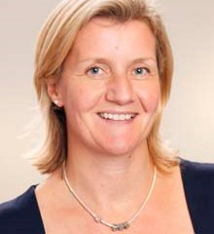
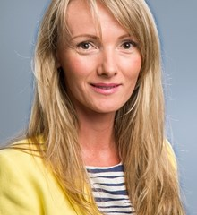
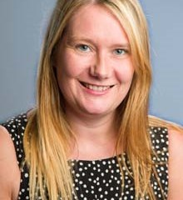
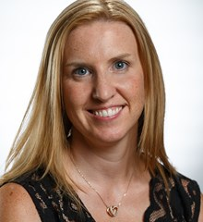
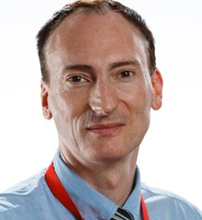
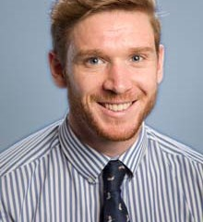
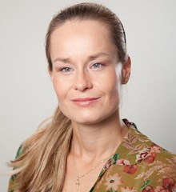
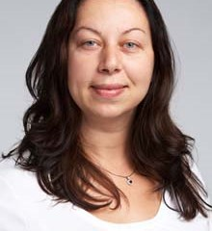
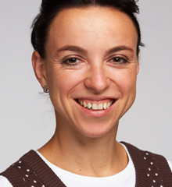
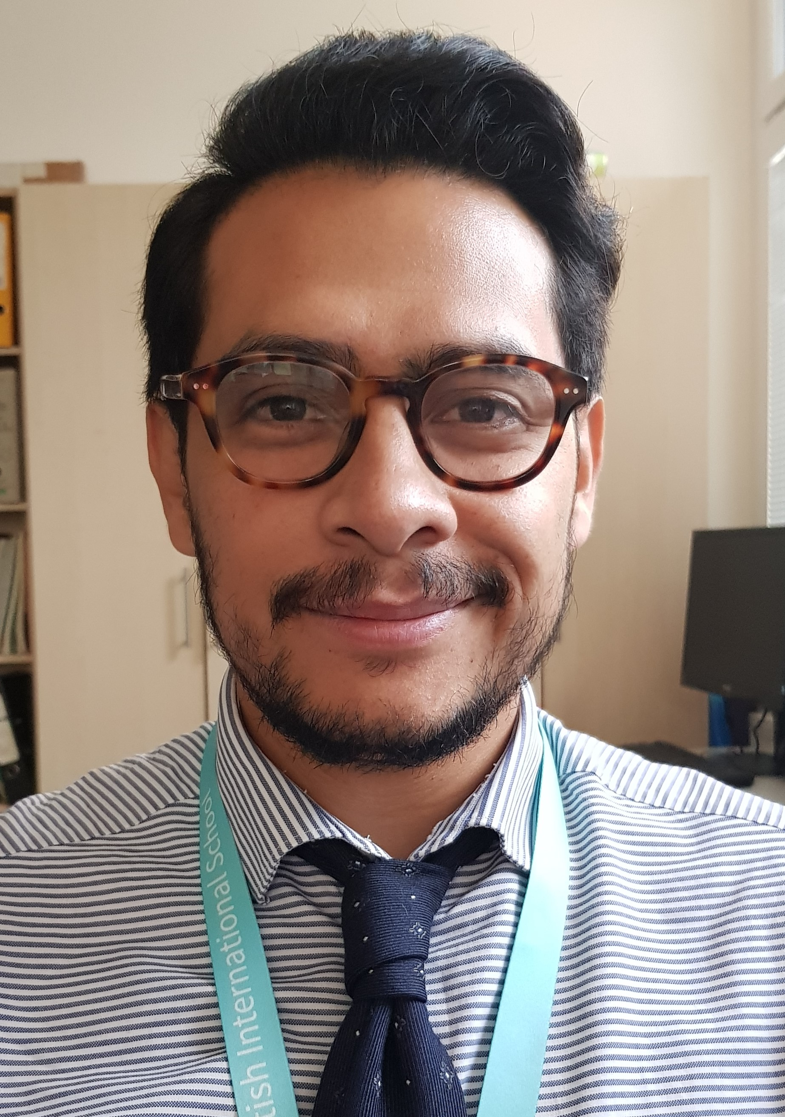
Meet the Team
Robert Reed
6A Teacher
robert.reed@pbis.cz
Victoria Lawlor
6B Teacher
Head of Year 6
victoria.lawlor@pbis.cz
Mairead Power
6CZ Class Teacher
mairead.power@pbis.cz
Hana Pfeiferova
6C Czech Teacher
Deputy Head of CZBS
hana.pfeirferova@pbis.cz
Kirstie McGill
6D Teacher
kirstie.mcgill@pbis.cz
Timothy Bottomley
Deputy Head Y4-6
Y6B Cover Teacher (Wednesday)
timothy.bottomley@pbis.cz
Victor Ayala
Y6 Assistant Teacher
Victor.Ayala@pbis.cz
Katerina Mrazkova
Y6 Assistant Teacher
katerina.mrazkova@pbis.cz
Sasha Long
Y6 Assistant Teacher
alexandra.nazarova@pbis.cz
Lucie Kovarikova
Y5 &6 CZ Assistant Teacher
lucie.kovarikova@pbis.cz

Slide 3
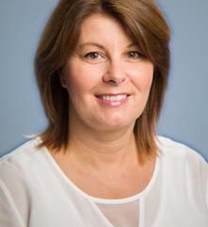
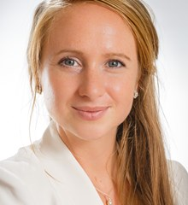
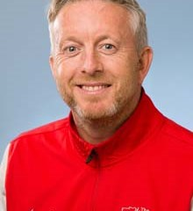
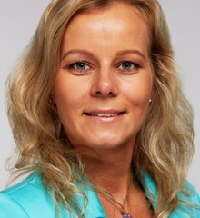
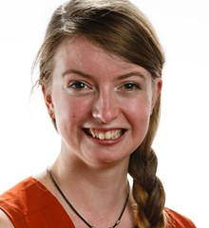
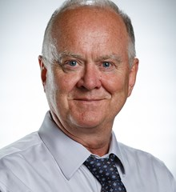
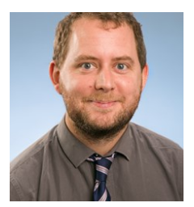
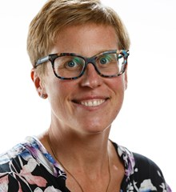
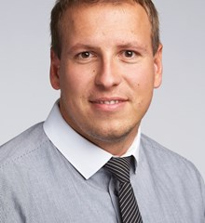
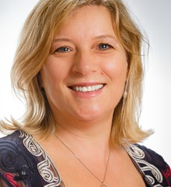
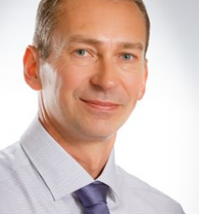
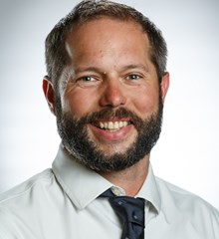
Support and Specialist Team
English as an Additional Language
Kamila Hamel
EAL Coordinator
Room: C 201
kamila.hamel@pbis.cz
Natalia Fajcikova
EAL Y6 Teacher
natalia.fajcikova@pbis.cz
Susanna Knuckey
Music Teacher
Andrea Burnham
School Librarian
Emma Brynes
Dance Teacher
Learning Support
Tricia Gray
Head of Learning Support
tricia.gray@pbis.cz
Mark Sigsworth
Learning Support Teacher
mark.sigsworth@pbis.cz
Joanna Denny
PE Teacher 6B
Marion Adamec
PE Teacher 6D
Filip Prochazka
PE Teacher 6A
Nicholas Hayes
PE Teacher

Slide 4
Year 6 - What to expect…
A collaborative effort​ between the school team, students and parents
Aspiring and realistic personalised targets (both academic and personal)​
Growth towards independence and an ability to operate independently in senior school by the end of the academic year
Increase opportunities for leadership roles and responsibilities

Slide 5
Communication
Please use email and/or the home-school diary as a means of communication – if your child is going to be late, has an appointment, is going home with someone else, etc.
Buses and Club cancellation is very important!
If your child is sick or absent for any reason, please email the class teacher and the Administrator for Y6-9 David Vo Tien
david.vo@pbis.cz
Please read the newsletter weekly
We have an open door policy, please speak with us regarding any concerns, for more confidential and longer discussions, please email the class teacher to ensure a suitable time.
Please raise any concerns or issues that you may have with the class teacher in the first case. If required, follow up or further discussion can be arranged with Head or Year and then subsequently the Deputy Head and Head of Campus.
Please don’t forget to share your positive thoughts with us also ☺

Slide 6
Beginning and End of Day Routines
Students should wait in main reception until 8.10am. Then they may go to their classrooms, not sooner as classes may be unsupervised and/or staff may be in meetings.
Students involved in the Czech for Czechs morning class must be in the Czech Programme classroom for 8.15am on Tuesday, Wednesday and Thursdays.
At 8:30am, students must be in class.
Main reception will record any student as ‘late’ regardless of reason after 8:30. The class teacher or administrator can change this according to the reason provided. Absences and ‘late’ are recorded on reports
At 3.20pm, children can be collected from outside their Year 6 classrooms unless they have a red sticker with agreed written permission from parents
Please be on time to collect your child as staff have other commitments such as clubs, duties and meetings to attend to after school day ends
If your child is not collected the parents will be contacted
“Red stickers” and permission
Permissions (if you want your child to wait alone, go to the gate unsupervised, wait for a sibling in senior school etc.), please send us written permission in the diaries and we will complete a red sticker.
Please note that children cannot play in front of the school (ever) or play unsupervised on the playground.

Slide 7
What to bring everyday
https://pbis.fireflycloud.net/joining-pbis/pbis-school-uniform/primary-uniform
School Uniform as outlined must be worn and adhered to, in exceptional circumstances that this can not to followed please communicate with your class teacher.
Please label everything including hats, scarfs, gloves, bags etc…
School uniform (labelled)
Indoor shoes – plain black
Healthy snack
Water bottle
Library / reading book
Diary
PE Kit
Homework book – on Tuesdays
Old shirt as art apron (optional)

Slide 8
The VLE and Seesaw
VLE class pages, which will have:
Homework https://pbis.fireflycloud.net/year-6-3/kamyk
Spellings
Recommended Year 6 reading books
Other important information e.g. Trip and consent forms
Seesaw:
Tool for sharing children's work with parents (student led)
Please sign up if you haven’t already done so. Email has been sent to parents.
Feel free to leave a comment!

Slide 9
PBIS Y6 Rewards and celebration of achievements
◦In Year 6 we are focusing on positive behaviour reinforcement through:
students being awarded individual house points throughout the week
selected students to receive WOW certificates every 2nd week in assembly
class flag points for team effort and conduct around school
Year 6 Wonder Wall – a display of excellent work produced by students as an example to others in Year 6
Year 6 Graduation at the end of the year - a celebration of primary school life

Slide 10
PBIS Sanctions Ladder
Behaviour Management

Slide 11
P.E. and Dance
Dance – every 2nd week
Dress code – dance entire or PE kits
Wednesday 6B (week A)
Wednesday 6D (week B)
Friday 6A (week B)
P.E. - part of the curriculum!
Wednesday and Friday (all classes)
P.E Kits: School P.E. kits are being handed out at the moment.
*Please provide a medical note if children cannot do PE.

Slide 12
The Curriculum
Mathematics – Following British National Curriculum
Streaming from week 4, after initial assessment have been evaluated, teacher observations, discussion with students. These groups are provisional and fluid.
Groups: Challenge class x 1 Core Class x 2
English – Following British National Curriculum
Taught within regular classes and differentiated accordingly
Reading, writing, speaking, listening, SPAG (Spelling, Punctuation and Grammar)
4 Novels throughout the year: 'Journey to the River Sea', 'The Boy in the Striped Pyjamas', 'Alice in Wonderland', 'Journey to Jo'burg'.
Students will complete regular assessments through the year and U.K. SATs papers for Maths and English will be used for the end of year assessment – results will be sent to parents during the summer holidays.

Slide 13
The Curriculum continued...
PSHCE - Weekly lessons timetabled plus activities for each class, at teacher's discretion and PSHCE assemblies focused on the Value of the Month and PSHCE whole school objectives
Computing – 1 hour per week plus cross-curricular opportunities
Drama – Drama will be incorporated into both English and the Creative Curriculum through, speech and drama, role-play, playscripts, movie reviews, presentation skills.
Specialists: Modern Foreign Languages, P.E, Dance and Music

Slide 14
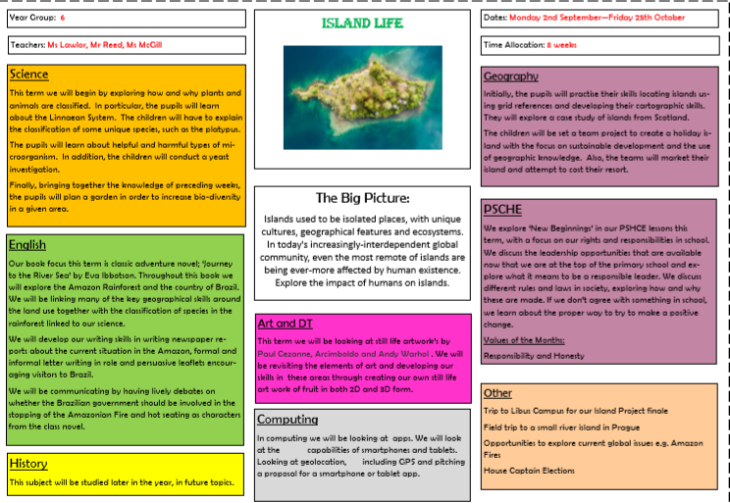
The Creative Curriculum
Based on 4 Key Themes across the year:
Island Life
Back in Time (World War 2)
Energy
Evolve and Adapt (including S.R.E - Sex and Relationship Education)
Within the themes Science, History, Geography, Art and DT national curriculum objectives will be taught as well as international studies and direct links to our Nord Anglia Initiatives.
Discrete Science and ART/DT lessons will be incorporated into the weekly timetable as well as general Creative Curriculum lessons.
Topic Maps

Slide 15
Nord-Anglia Initiatives
Juilliard - School of Performing Arts
STEAM (Science, Technology, Engineering, Art and Maths) in collaboration with MIT (Massachusetts Institute of Technology)
UN Global Goals for Sustainable development in collaboration with UNICEF
Review of all the Global Goals to be incorporated in the curriculum
Nord Anglia Global Campus

Slide 16
Homework
Set on Thursday due in on Tuesday (maths, English, creative curriculum)
Approx. 20 mins per piece of homework
Please keep us informed of any problems with completing homework – we can be flexible!
Guidelines for homework are printed and displayed in the front of students' homework books

Slide 17
Spelling...
Spellings
Each week students will receive a weekly spelling list on VLE to practice and learn for a spelling test will be conducted on Fridays
These words will also be displayed on 'Spelling City' website for optional practice
Spelling list will follow the spelling rules mandatory for Y6 students and students will also have lessons dedicated to the rules during the weekly English lessons
During Term 1 students will review the Year 3-6 statutory words for Primary
School and will be encouraged to take responsibility for their own learning

Slide 18
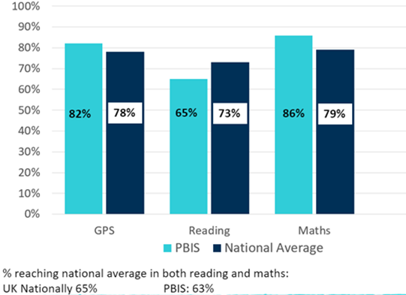
Reading...
Year 6 2018-19 SATs results
These results reflect the whole primary journey.
Parent support is essential for reading progress.
PBIS big focus is on reading in the primary school.
All students should spend 20 minutes reading at home every day, including books in home language as well as in English
Reading should be recorded in the homework diary. (Name of book, how many pages/which chapter, comments by student or parents are encouraged)
Students should read their class English novel as directed by the teacher
Library books, students can take 3 books (they should always have 1 fiction and 1 non-fiction and another of free choice if desired)
Library times:
6A - Thursday, 6B –Monday, 6D -Thursday
Parents encourage home reading by listening, reading with their child, asking questions (see reading guidelines for parents)
Explore the 50 recommended reads for Year 6 – on VLE and displayed in all classes
Reading scheme – students on the school reading scheme should change books regularly to work towards becoming 'free readers'.
Students and parents may also visit the library before and after school to change books

Slide 19
Get Involved
Help in school, helping on trips, guest speakers, graduation support committee – contact your class teacher.
Become a class representative – please speak with your class teacher and contact Mr Baker (paul.baker@pbis.cz).
Join the Kamýk Friends Association.
Visit the parents’ room for a coffee and a chat.
Saturday sports classes, adult choir.
Show and Share Mornings in classes once a term
Join in our family events

Slide 20
Optional Home Learning Activities
https://login.mathletics.com/
https://nrich.maths.org
https://ttrockstars.com/login
https://readingeggspress.com/
https://www.spellingcity.com/users/pbisyear6
https://scratch.mit.edu/
http://www.sciencekids.co.nz/experiments.html
http://www.dkfindout.com/uk/

