Slide 1
PBIS Year 4 Welcome Meeting

Slide 2
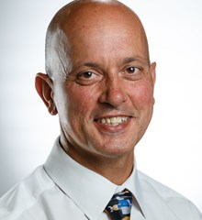
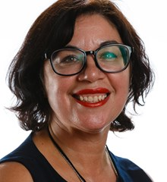
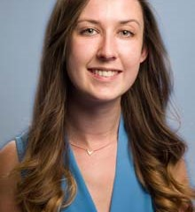
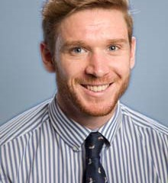
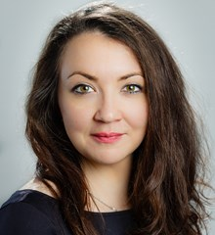
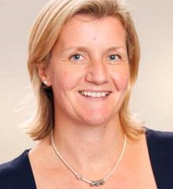
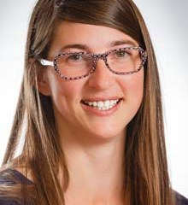
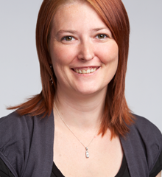
Our Staff
Mr Jaffari
Year 4A
Mrs Culek
Year 4B
Ms Clark
Year 4D
Head of Year 4
Mr Bottomley
Deputy Head: Year 4-6
Ms Dolezalova
Teaching Assistant
Mrs Acsayova
Teaching Assistant
Ms Suchomelova
Year 4C
Czech Programme Teacher
Mrs Power
Year 4C English
Notes:
Emily

Slide 3
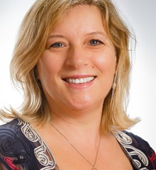
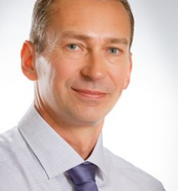
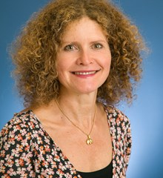
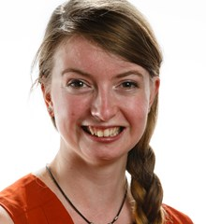
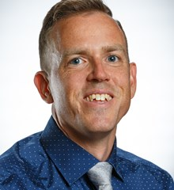
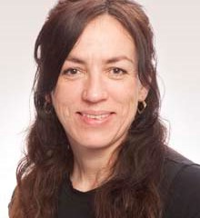
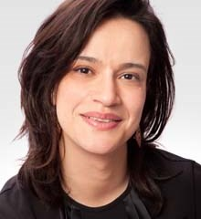
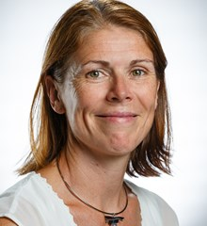
Specialist Teachers
Mrs Gray
Head of Learning Support
Mr Sigsworth
Learning Support teacher
Ms Hamel
EAL Coordinator
Ms Knuckey
Music Teacher
Mr Quesnell
Spanish Teacher
Ms Liborova
German Teacher
Ms Blua
German Teacher
Mrs Santrain
French Teacher
Notes:
Sharon

Slide 4
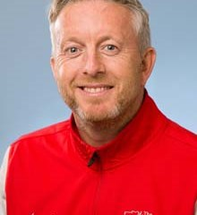
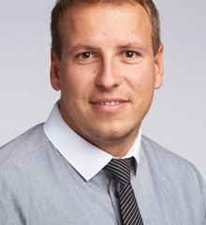
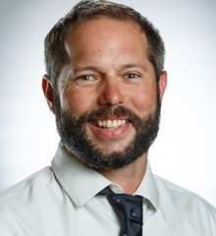
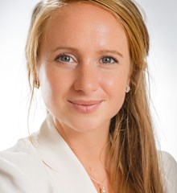
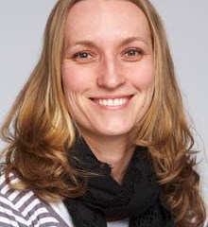
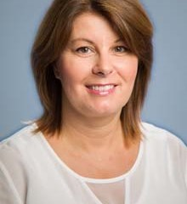
Specialist Teachers
Mr Hayes
4A PE Teacher
Mr Adamec
4B PE Teacher
Mr Prochazka
4D PE Teacher
Ms Byrne
Dance Teacher
Zdenka Hrebejkova
Administrator: Year 3-5
Petra Di Maio
Medical Assistant
Ms Andrea Burnham
Librarian
Notes:
Cormac

Slide 5
Teacher Contact Information
Cormac.jaffari@pbis.cz - Year 4A Teacher
Sharon.culek@pbis.cz - Year 4B Teacher
Lenka.suchomelova@pbis.cz - Year 4C Teacher & Czech Programme Teacher for Year 4​
Mairead.power@pbis.cz - Year 4C English Teacher
Emily.clark@pbis.cz - Year 4D Teacher & Head of Year 4
Timothy.bottomley@pbis.cz - Deputy Head for Y4-6 & Cover Teacher for Year 4D (Thursday morning)
Zdenka.hrebejkova@pbis.cz – Year 4 administrator
Notes:
Cormac All available on VLE

Slide 6
Communication
Please email and/or use the home-school diary as a means of communication – if your child is going to be late, has an appointment, is going home with someone else, etc.
“Red stickers” and permission - If you want your child to wait alone, go to the gate unsupervised, wait for a sibling in main reception etc., please send us written permission in the diaries, or through email and we will complete a red sticker.
If your child is sick or absent for any reason, please email the class teacher and Ms Hrebejkova.
Buses and Club cancellation is very important! Please also email class teacher and Ms Hrebejkova.
Please read the newsletter weekly and visit the VLE for details of weekly homework, recommended reading and event sign-ups.
https://pbis.fireflycloud.net/year-4-3/kamyk
Notes:
Sharon

Slide 7
Open Door Policy
Our doors are always open.
If you or your child has any issues, please first speak to the class teacher.
Then, if needed, the situation can be taken to the Head of Year.
If the situation is still unresolved, the issue can be taken to the Deputy Head for Years 4-6 and Head of Campus.
Also, if there are some positives you want to share, please let your class teacher, HoY and/or Deputy Head know too ☺
Notes:
Emily

Slide 8
Notes:
Emily

Slide 9
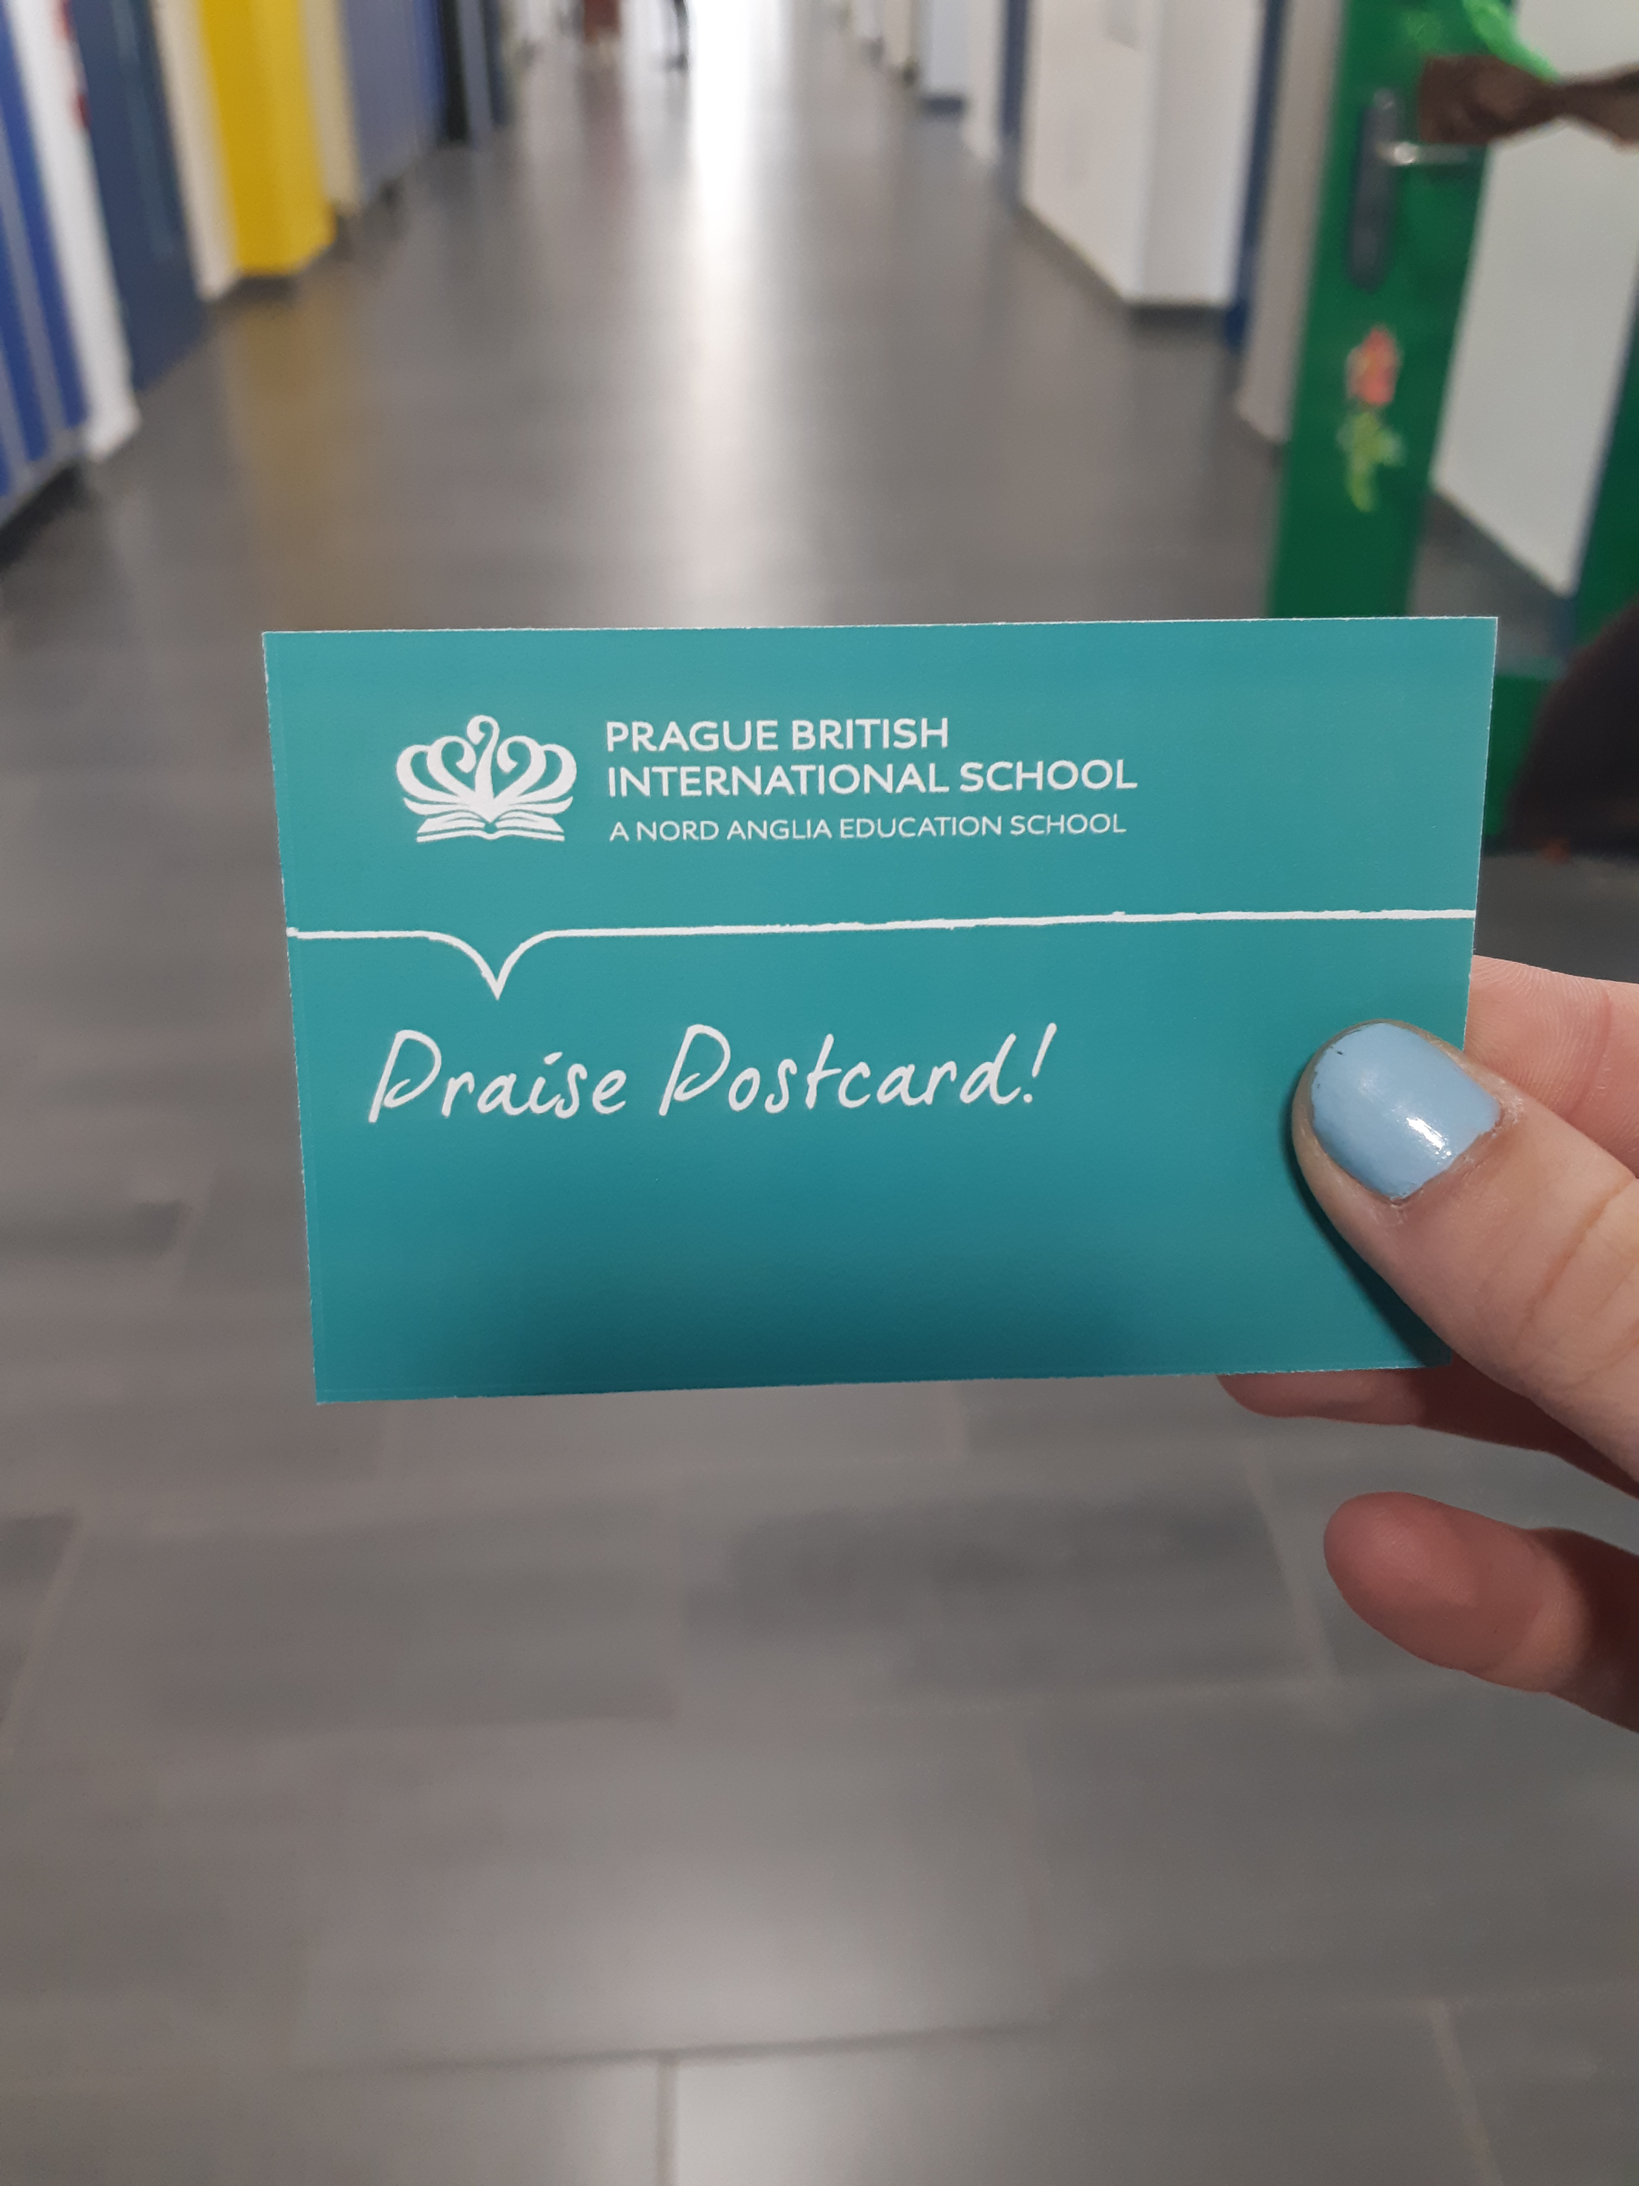
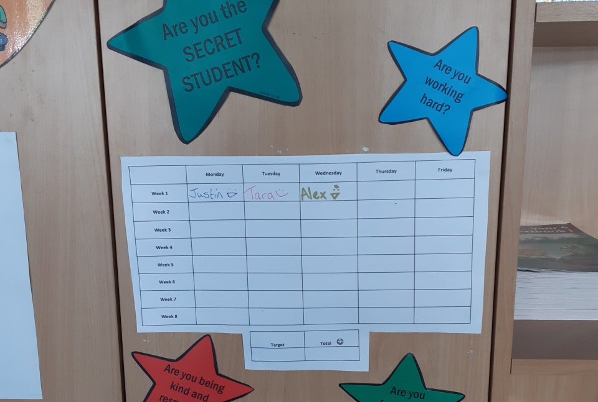
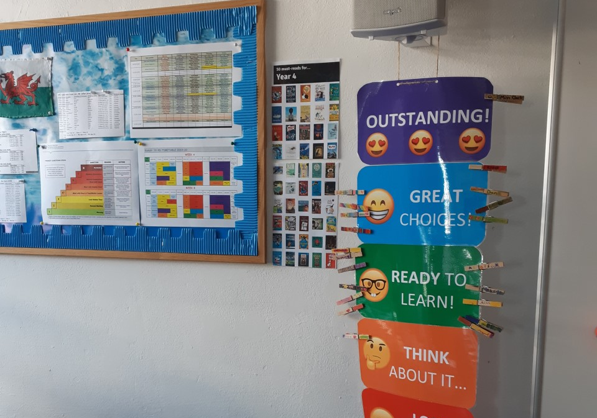
Behaviour Management in Year 4
Year 4 classes are using a visual behaviour chart and ‘Secret Student’, as well as house points, WOW certificates and praise postcards.
We are focusing on positive behaviour reinforcement!
Notes:
Cormac

Slide 10
Start and End of Day in Year 4
Students can start making their way to classes from 8:10. They should not come to the classroom before then. A song will play in main reception and the children can start walking to class.
At 8:30, students must be in class. After this time, the main reception will record any student as ‘late’ regardless of reason. The class teacher or administrator can change this according to the reason. Absences and ‘late’ are recorded on reports.
At 3:15, children can be collected outside their Year 4 classroom. Clubs begin at 3:20 and end at 4:00.
Please note that children cannot play in front of the school or play unsupervised on the playground. A parent must be with them.
Children cannot play in the Early years playground after school. This is because they are trying to create a learning environment with resources left outside, there is also a garden and classroom area.
Notes:
Children who have not been picked up at 3:15 will be taken to main reception and then enrolled in Extra Time
Sharon

Slide 11
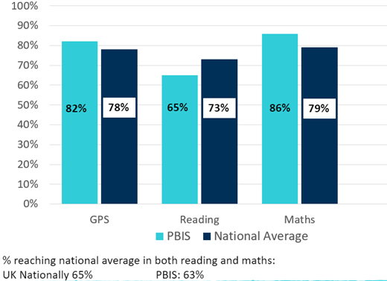
Year 6 SATs Results
These results reflect the whole primary journey.
Parent support is essential for reading progress
https://pbis.fireflycloud.net/year-4-3/kamyk/reading-resources-and-tips

Slide 12
Reading everyday with your child is essential.
Please read library books and initial the home-school diary to show that reading has taken place. Diaries will be checked and signed by teachers and assistants.
Many children will have a levelled reading book, as well as a library book. They can move up through these levels, progressing in their reading skills until they become ‘free readers’. The class teacher will decide if your child should move up a level.
Homework example… Week A: Reading Eggs and written Maths. Week B: Mathletics and English writing.
Spellings will be stuck into diaries and tested on Fridays. We will also be looking at word origins, prefixes and suffixes.
Every 8-week topic, we will give a ‘Creative Curriculum’ project, which your child will have a longer time period to complete.
Homework and Reading in Year 4
Notes:
Cormac

Slide 13
Reading Eggs

Slide 14
TimesTablesRockstars
Mathletics
Times table practise
Times table events
Wristband rewards for speed
Extensive practise and games
To be used in class and as homework

Slide 15
Our Curriculum Topics in Year 4
Four 8-week topics and four 1 week, theme weeks in the year (e.g. Art week).
Thematic approach using the topic as a base for many lessons in the curriculum to make links and use integration opportunities across all subjects.
Topics -
Remarkable Rainforests
Crafty Creators
Groovy Greeks
Intrepid Explorers
Creative curriculum includes science, history, geography art and design technology.
Other subjects – English, Maths, PE, music, reading, PSHCE and computing.
Notes:
SHARON
Remarkable Rainforests
Rainforests once covered 14% of our world’s surface. Now they cover less than 5%. Every second, an area of the rainforest the size of a football field is being destroyed. Scientists believe that, if we lose our rainforests, we will put our whole planet at risk. What should we do to help save the rainforest?
Crafty Creators
Inventions have transformed the way that we live our daily lives – from the simple paperclip to the latest mobile device. By learning about the important inventions that have changed our world, we can discover how we could become great inventors too.
Groovy Greeks
The Greeks told stories, not just to entertain but as a means of passing on their history, beliefs and culture. Many of these stories we refer to as myths and legends, stories that are timeless and are as relevant today as when they were first told. By studying these myths and legends we can learn more about the Greek people and their culture, and understand how we - today - can adapt and craft our own stories for future generations to enjoy.
Intrepid Explorers
Do you love discovering new places? Yes? Well you might just be an explorer. Explorers are people who travel to new places in the world and discover new things that they didn’t know existed. So much of what we know today about our world is because we have been explorers in the past. Being an explorer is exciting but scary at the same time. Could you be an explorer? Let’s find out.

Slide 16
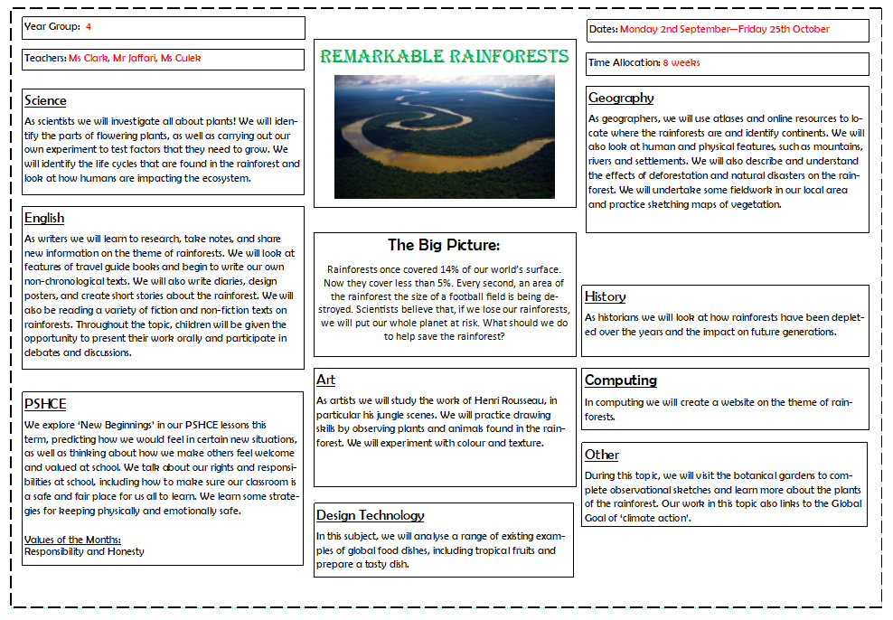
Topic Map
Notes:
sharon

Slide 17
SeeSaw
Please Sign Up
Click on your class link…
4A: https://app.seesaw.me/s/778-795-363
4B: https://app.seesaw.me/s/106-312-967
4D: https://app.seesaw.me/s/967-672-546
Choose your child from the list
Create your account
Once the teacher approves you, you can see content from your child
After you sign up, download the free Seesaw Family app and sign in. You can also access Seesaw from a computer at https://app.seesaw.me.
Thank you for supporting your child's learning!

Slide 18
What does my child need?
School uniform (labelled)
Indoor shoes
Healthy snack
Water bottle
Library / reading book
Diary
PE Kit / Dance kit
Homework book

Slide 19
How can I get involved?
Helping in class, reading in class, helping on trips, guest speakers – contact your class teacher.
Parent teacher association
Become a class representative – contact Mr Baker (paul.baker@pbis.cz).
Join the Kamyk Friends Association.
Visit the new parents’ room for a coffee and a chat.
Saturday sports classes,
Show and Share in classes once a term.

Slide 20
Any questions?

