Slide 1
PBIS Year 5 Welcome Meeting

Slide 2
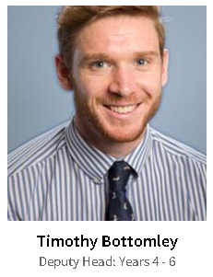
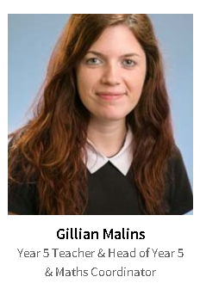
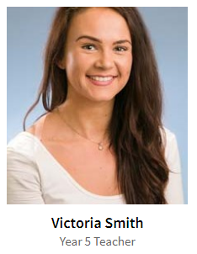
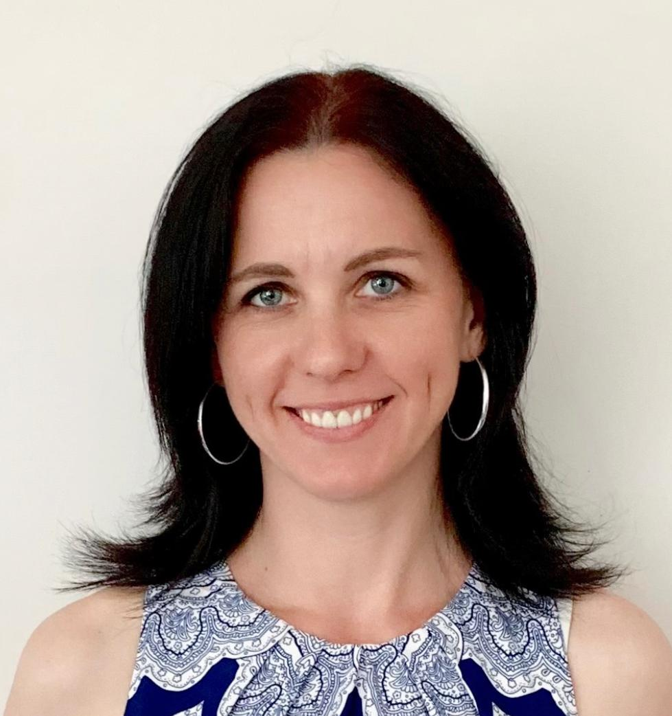
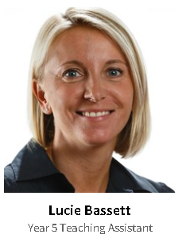
Martina Nemcova
:)
Y5C TA and C for Foreigners teacher
Lenka Heidari
Year 5 Teaching assistant

Slide 3
School Uniform
https://www.nordangliaeducation.com/schools/prague/british-international/school-life/school-uniforms
The PBIS uniform range for both Primary (Early Years to Year 6) and Secondary (Years 7 to 11) includes:
navy blue v-neck jumper
navy blue v-neck cardigan
teal polo shirt (short and long sleeved versions available)
navy blue crew neck sweatshirt
navy trousers / shorts / skirt / skort / pinafore
navy fleece
navy hoodie
Comfortable shoes for outside (that they can run around in)
Please label everything!!!
Please send an old t-shirt to school with your child – clearly named – for art.

Slide 4
P.E. and Dance
There will be 2 P.E. sessions a week. Every second week, one of these sessions will be Dance.
Please check your child's timetable to find out which days these are.
Please note there may be a difference between Week A and Week B
Everyone has P.E. / Dance at 9am on Thursday – can you please send children to school in their P.E. kit on this day.
Kit: Please order at https://www.kukrisports.co.uk/teamshop/praguebritishinternationalschool/productNavListNg.action
It will be delivered to school and given to children shortly.
Children should remove earrings and tie their hair up.

Slide 5
What to Bring Everyday?
Home-School Diary
Reading Books
Library Books
Children will visit the library at least once a week with their class. However, they can change their books any day.
Water bottle
Healthy snack for morning break
Indoor shoes/ slippers (can be kept in lockers)

Slide 6
Lockers
Each child has been assigned a locker outside their classroom.
They do not need a padlock for this and they should not have one.
The primary school now has a Week A and Week B system.
The new school year started on Week A (week beginning 2nd September), now we are on week B. This rotation will continue for the year.
Your child will have a week A and week B timetable but there are only one or two small differences between them.
Timetables

Slide 7
Our Curriculum Topics in Year 5
Four 8-week topics and four 1 week, theme weeks in the year.
The Topics: Wonderful World Horrid Histories Chemical Chaos Raging Rivers
Creative curriculum includes science, history, geography art and design technology.
Other subjects – English, maths, PE, music, phonics, reading, PSHCE and computing.
Thematic approach using the topic as a base for many lessons in the curriculum to make links and use integration opportunities across all subjects.

Slide 8
Electronics and E Safety
Children may bring phones to school, but these should be switched off and kept in their bags until 3.15pm.
We will be using the internet on laptops and iPads.
Please support safe internet use at home too by having conversations with your children about safe use and supervision when visiting websites.

Slide 9
Ordering Lunches
You can sit with your child and order their lunches for two weeks in advance.
Helps to ensure they will like and eat the food.
Soup – main dish –fruit
Children can put up their hand and ask for extra if finished and still hungry.
Playground after school

Slide 10
Birthdays
We enjoy celebrating the children's birthdays at school. If you would like to send a treat for this, please send cupcakes/ muffins rather than a whole cake as this makes it much easier for us!
Please avoid sending in extra 'party food'.
Please check with the teacher about allergies. Please avoid nuts.

Slide 11
Seesaw (App) and VLE
We will be using the app, Seesaw, as a learning journal/portfolio to share our work in school.
Each parent will be able to see their child’s work and comment on it.
Please speak to your child's class teacher if you are not sure how to access this.

Slide 12
Homework in Year 5
DAILY
Reading everyday is essential.
Please read library books and/or reading scheme books and initial the home-school diary to show that reading has taken place. Teachers or TAs will check and initial the diary also.
WEEKLY
Spellings will be stuck into Homework books and tested on Friday. Spelling lists may be longer or shorter depending on abilities, however, all children are taught the same spelling rules. An activity may be included e.g. sentence writing. Their score will be recorded in their diary every Friday.
Maths and English: A weekly activity based on what we have been learning. This might be worksheets, reading comprehension, a writing task, online task or a practical activity.

Slide 13
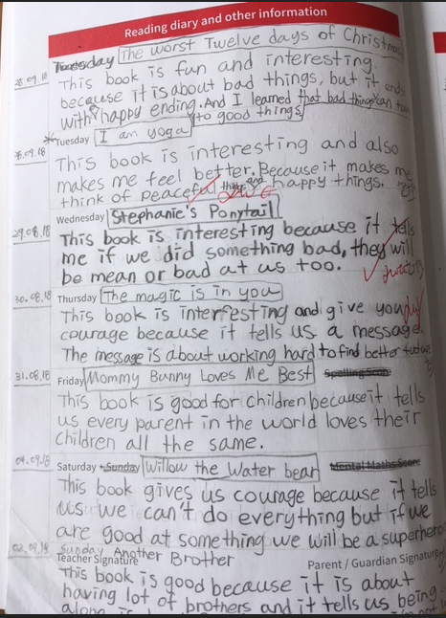

Slide 14
Homework Schedule
Homework will always be posted on the VLE .
It can then be completed in HW books.
Weekly homework will be given on a FRIDAY and should be returned every WEDNESDAY.
To promote independence, we will be encouraging the children to take charge of their own homework responsibilities. As such, if a child repeatedly( 2 times or more) doesn't complete their homework/ it is late, they will lose 10 minutes of golden time.

Slide 15
Advice for READING AT HOME:
https://pbis.fireflycloud.net/year-5-3/reading-resources-and-tips
Follow the link to a page on the Year 5 VLE.
Feel free to add a comment to the page with some ideas you have for helping your child read at home that you would like to share.

Slide 16
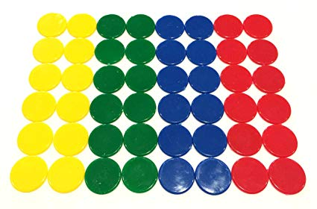
How to we motivate and praise the children?
Flag points – awarded to classes to win Class of the week (15 minutes extra playtime)
House points – awarded to individuals for excellent work/ behaviour.
Golden time – 2.20 – 2.50 every Friday
The children may lose Golden Time after a warning in blocks of 10minutes. If your child loses Golden time, they will bring home a reflection form for you to sign and return to the class teacher.
In class reward systems

Slide 17
InFORMATION AND GUIDANCE FOR pARENTS
There is lots on the VLE:
Maths: https://pbis.fireflycloud.net/mathematics-9
Reading with your child:https://pbis.fireflycloud.net/year-5-3/reading-resources-and-tips
Learning Objectives for Year 5: https://pbis.fireflycloud.net/year-5-3/english-and-maths-learning-objectives
Topic maps: https://pbis.fireflycloud.net/creative-curriculum
Our class pages are here: https://pbis.fireflycloud.net/year-5-3/kamyk

Slide 18
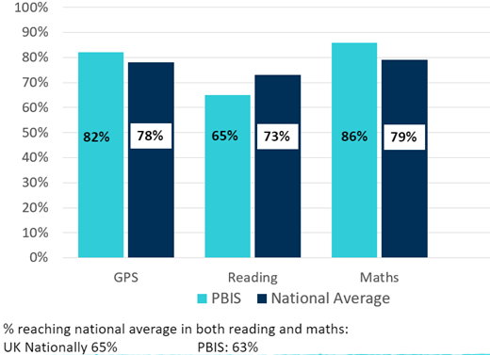
Whole School reading focus

Slide 19
Communication
Please use email and/or the home-school diary as a means of communication – if your child is going to be late, has an appointment, is going home with someone else, etc.
Buses and Club cancellation is very important!
If your child is sick or absent for any reason, please email the class teacher and Ms Zdenka
zdenka.hrebejkova@pbis.cz
Please read the newsletter weekly.

Slide 20
Open Door Policy
Our doors are always open.
In the first instance, please talk to your class teacher about any issues you have.
Then, if needed, the situation can be taken to the Head of Year.
If the situation is still unresolved, the issue can be taken to the Deputy Head for Yrs 4-6 and Head of Campus.
Also, if there are some positives you want to share, please let your class teacher, HoY and/or Deputy Head know too ☺

Slide 21
How can you get involved?
Comment on Seesaw!
If you would like to help with hearing the children read in Year 5, please contact your child’s class teacher.
If you have any skills or contacts that would help enrich the topics we are learning about, please let us know.

Slide 22
Thank you from all of us
victoria.smith@pbis.cz (5A teacher)
gillian.malins@pbis.cz (Head of Year and 5B teacher)
mazhar.ghaffar@pbis.cz (5D teacher)

Slide 23
Parents Evening
10. 9. 2019
Y5 Czech programm
Jolanta Heczková (jolanta.heczkova@pbis.cz)

Slide 24
Program
organizace dne
učební plán
domácí příprava
hodnocení

Slide 25
Organizace dne
Hodiny ČJ – 3x týdně
Úterý + středa – český jazyk
Čtvrtek – Člověk a jeho svět (1.pololetí – Naše vlast = zeměpis, 2. pololetí – Dějiny, Přírodověda – jednou za měsíc formou prezentace + zvířata)
Výuka začína v 8:15!!!

Slide 26
Učební plán
Český jazyk
Opakování 3.třídy – nauka o slově, stavba slova, vyjmenovaná slova
Slovní druhy
Podstatná jména
Skloňování podstatných jmen
Slovesa
Stavba věty
Slohová cvičení
Čtenářský denník – 4 knihy za rok, kontrola před pololetím, před koncem roku, doporučené knihy na VLE
Člověk a jeho svět (zeměpis)
Česká republika – demokratický stát
Kraje a krajská města
Mapa a orientace v krajině
Povrch a vodstvo ČR
Počasí a podnebí ČR
Půda, zemědělství a průmysl v ČR
Člověk a jeho svět (dějiny)
Lidé a čas + za dávných časů
Slovanské osídlení + Sámova říše
Velkomoravská říše
Přemyslovská knížata
České království za vlády Přemyslovců
Lucemburkové v Čechách
Husitství a doba pohusitská
Nástup Habsburků na český trůn

Slide 27
Domácí příprava
domácí úkoly každý den, vypracované musí být do příštího úterý, informace o domácích úkolech přímo v učebnici nebo PS a na VLE
čtení nejlépe denně podle stupně únavy dítěte
Psaní
Píšeme PEREM!

Slide 28
Hodnocení
Klasická česká stupnice známkování

