Slide 1
PBIS Year 1 Welcome Meeting

Slide 2
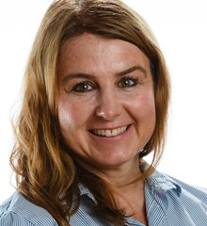
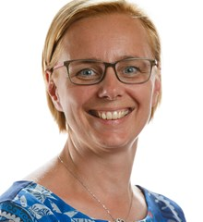
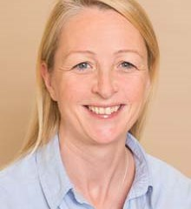
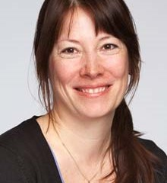
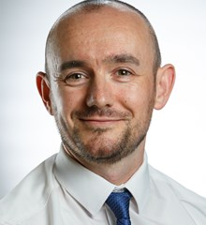
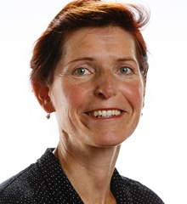
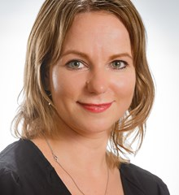
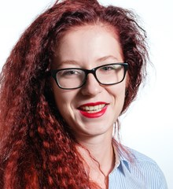
Our Staff
Year 1B
Year 1A
Andrea Vermirovska
Administrator
Year 1D
Year 1C

Slide 3
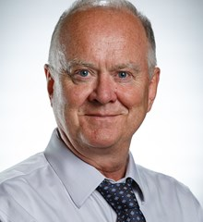
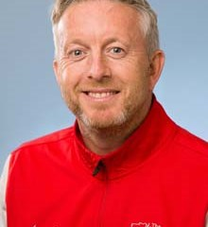
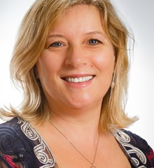
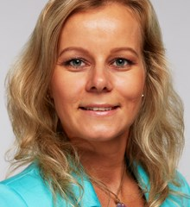
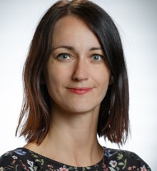
Specialist Teachers
Music
Mr Coleman
PE
Mr Hayes
Learning Support
Mrs Gray
EAL
Ms Fajcikova
Librarian
Ms Novekova

Slide 4
Teachers Contacts Class teacher email:
sacha.woodrow@pbis.cz 1B
zoe.harrison@pbis.cz 1A
adrian.ferguson@pbis.cz 1D
martina.vojackova@pbis.cz 1C
Administration Contact andrea.vermirovska@pbis.cz

Slide 5
Open Door Policy
Our doors are always open. Please come and see us. We are always able to chat to you and we are happy to help!
In the first instance, please talk to your class teacher about any issues you have.
Then, if needed, the situation can be taken to the Head of Year.
If the situation is still unresolved, the issue can be taken to the Deputy Head for Yrs1-3 (Mr Whitten) and Head of Campus (Mr Baker).
Also, if there are some positives you want to share, please let your class teacher, HoY and/or Deputy Head know too ☺

Slide 6
Communication
Please email and/or use the home-school diary as a means of communication e.g. if your child is sick, absent, not attending club or changes to pick up/bus.
Please include Ms Andrea and class teacher in these emails. (andrea.vermirovska@pbis.cz)
Please read the newsletter weekly and check your emails from the VLE (Firefly), maths videos, presentations.

Slide 7
Start and End of Day in Year 1
At 8:30, students must be in class. Students can come into class from 8.15, not any sooner.
Czech Programme begins at 8:15.
Main reception will record any student as ‘late’ after 8:30 but class teacher or administrator can change this according to the reason. Absences and ‘late’ are recorded on reports.
Children can be collected from outside their classrooms at 3:15. Wait at the top of the stairs until pick up time.
Children cannot play in front of the school or play unsupervised on the playground.
Red stickers on diaries for permission to be picked up on a regular basis by siblings or other adults.

Slide 8
Our Curriculum Topics in Year 1
Four topics (approximately 8 weeks) plus theme weeks(eg Art week).
Thematic approach using the topic as a base for many subjects in the curriculum to make links and use integration opportunities across all subjects.
Topics =
Holidays
Marvellous Toys
Castles and Crowns
Live and Let Live
Creative curriculum includes science, history, geography art and design technology.
Other subjects – English (including phonics, reading & library), maths, PE (including dance & swimming), music, PSHCE and computing.

Slide 9
Seesaw (App)
We will be using the app, Seesaw, as a learning journal/portfolio to share our work in school.
Each parent will be able to see their child’s work and announcements from class teachers.
Your class teacher will provide you with a sign up letter so you can access your child’s journal on your phone, tablet or computer.
VLE

Slide 10
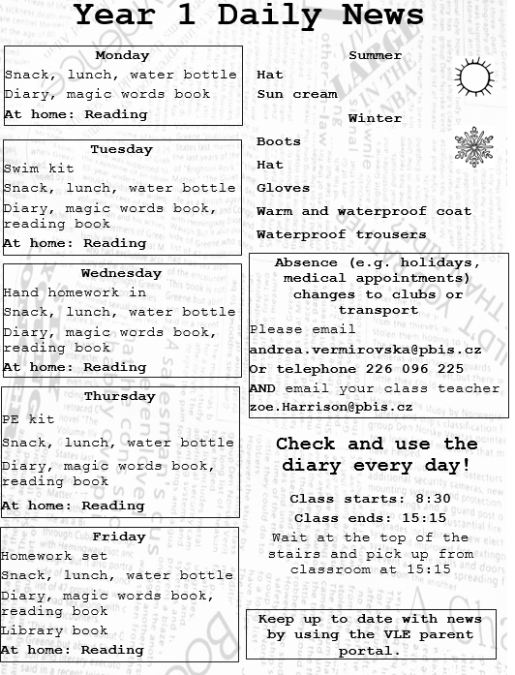
What does my child need?
School uniform (labelled)
Healthy snack and water (no nuts)
Lunch – packed lunch or order online
(Allergies and food avoidance – inform class teacher)
Reading book
Diary
Indoor shoes
Outdoor clothing
Magic Words book
Library book
Homework book
PE Kit

Slide 11
What does my child need?
Swim kit
Please ensure that your child brings the following items in a separate bag:
· Swimming costume
· Pool-side shoes, e.g. flip flops or Croc type shoes
· Towel
· Hair brush
· Swimming hat (especially for children with long hair)
· Soap or shower gel

Slide 12
How can I get involved?
Helping in class, reading in class, helping on trips, guest speakers (theme weeks) – contact your class teacher.
Home learning, workshops.
Join the Kamyk Libus Friends – Tony Peachment (anthony.peachment@pbis.cz).
Become a class representative – contact your class teacher or Mr Baker (paul.baker@pbis.cz).
Visit the parents’ room for a coffee and a chat.
Saturday sports classes, adult choir.
Show and Share in classes once a term – please check the calendar.
Welcome to attend assemblies.
Whole school events.

Slide 13
50 must reads

Slide 14
50 must reads continued

Slide 15
Thanks for listening. We’re here for you!
Any questions?

