Slide 1
Early Years 2019 - 20

Slide 2
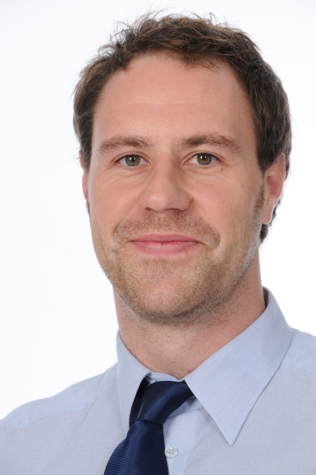
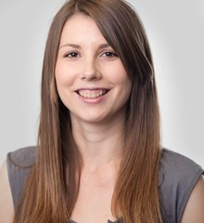
Our staff
Mr Alex Harrison
Deputy Head Kamyk Campus (Early Years)
Responsible for the overall management of the Early Years
Involved throughout Primary school.
Ms Eliška Strnadová
Pre-Nursery Teacher
Early Years Coordinator
Responsible for the day to day running of the Early Years
Notes:
Introduction – as you may or may not know my new role this year is foundation stage coordinator…..

Slide 3
Our Staff
Miss Andrea Vermirovska:
EY – Year 2 Administrator
Miss Eva Roubikova: catering, cleaning…

Slide 4
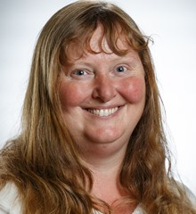
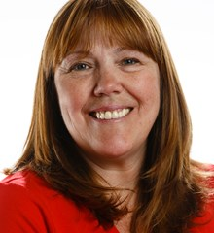
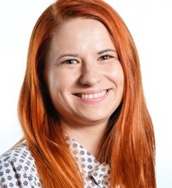
Teaching Assistants
Mrs Jana Němcová Mrs Mandy Renwick
(Monday and Tuesday) (Wednesday, Thursday and Friday)
Mrs Katarzyna Książkiewicz
(Monday to Friday)

Slide 5
Our Curriculum
Personal, Social and Emotional Development
Self confidence and self awareness
Managing feelings and behaviour
Making relationships
Communication and Language
Listening and attention
Understanding
Speaking
Physical Development
Moving and Handling
Health and self-care

Slide 6
Specific Areas
Literacy
Reading
Writing
Mathematics
Numbers
Shape, space and measures
Understanding the world
People and communities
The World
Technology
Expressive arts and design
Exploring and using media and materials
Being imaginative

Slide 7
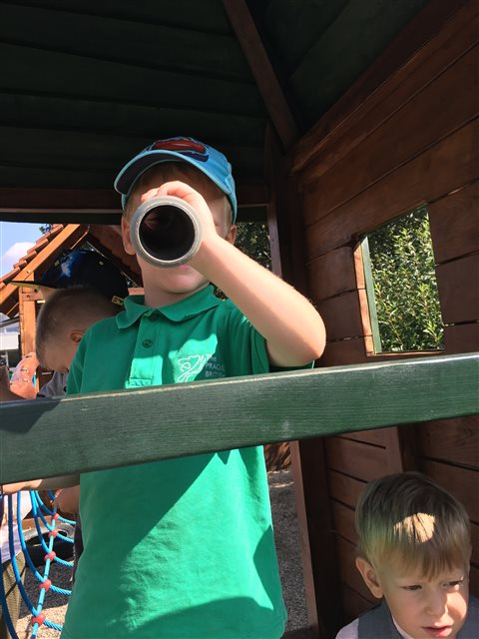
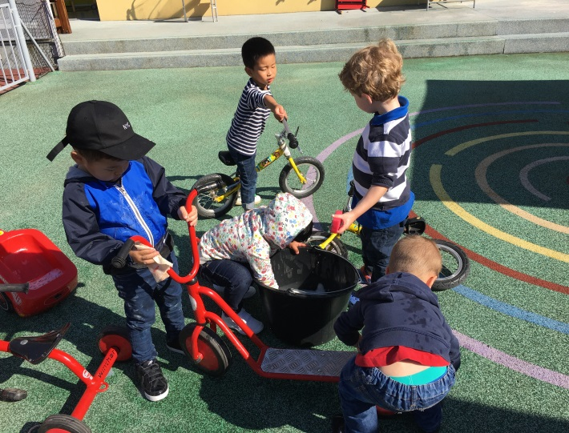
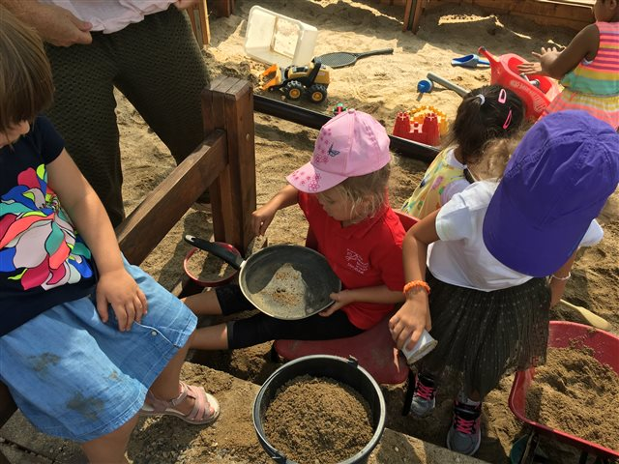
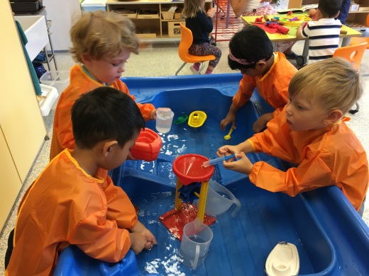
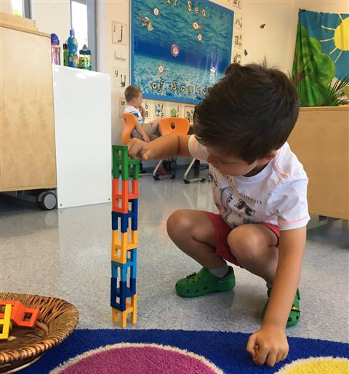
Learning Through Play
• Through play children discover new things about the world they live in.
Children need to be interested in what they are learning and enjoy what they are doing.
• They develop new skills and build new relationships.
All areas of the EYFS are taught cross curriculum throughout the day.

Slide 8
Plan of The Day
8.15am – 9.15am: staggered start + independent activities, communication time. This is often called ‘freeflow’.
9.15am – 9.30am: tidy up and circle time
9.30am – 10.30am snack and outside play
10.30am – 11.30am continuous provision and/or specific
sessions (e.g. library)
11.30am – 11.40am: preparing for lunch
11.40am – 12.20am: lunchtime
12.20am – 2.30pm: nap time or continuous
provision
2.40pm – 3.00pm: snack
3.00pm – 3.15pm staggered finish, communication
time

Slide 9
Drop Off
The children arrive at school any time from 08.15 am until 08.45 am.
This is also communication time.
Parents are encouraged to bring their child into the classroom and say good morning to the teachers. You are welcome to settle them before saying goodbye.
Teachers encourage the children to choose an activity to complete with their friends.

Slide 10
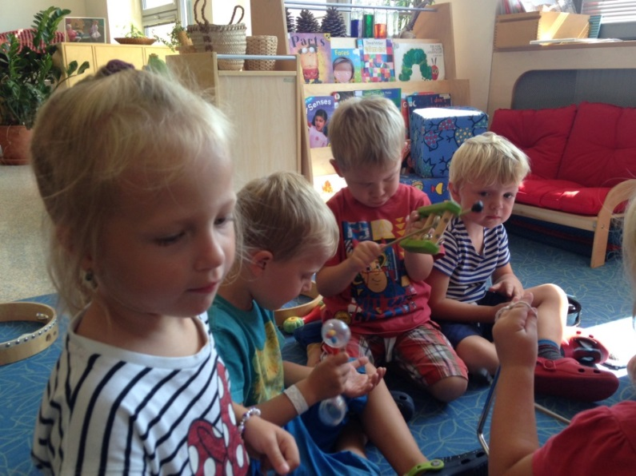
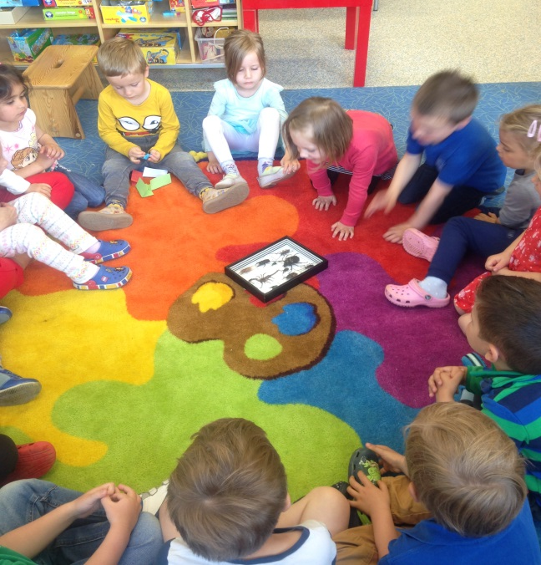
Circle Times
We have circle times every day
In circle time we:
Say hello and discuss our day;
Sing songs;
Read stories etc.

Slide 11
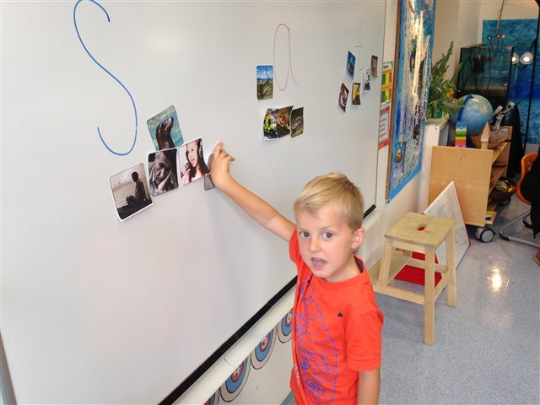
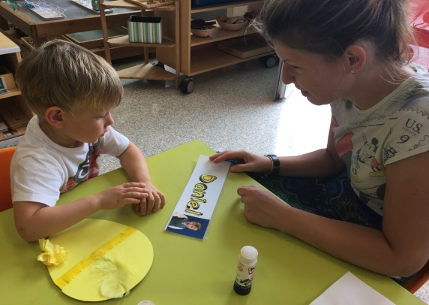
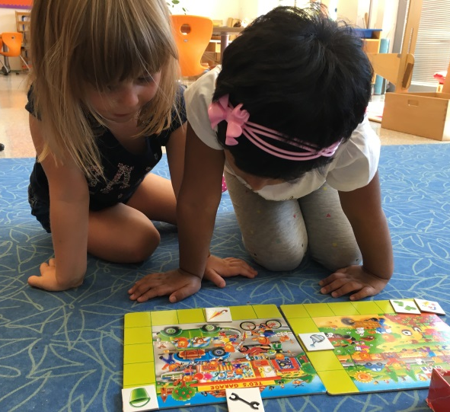
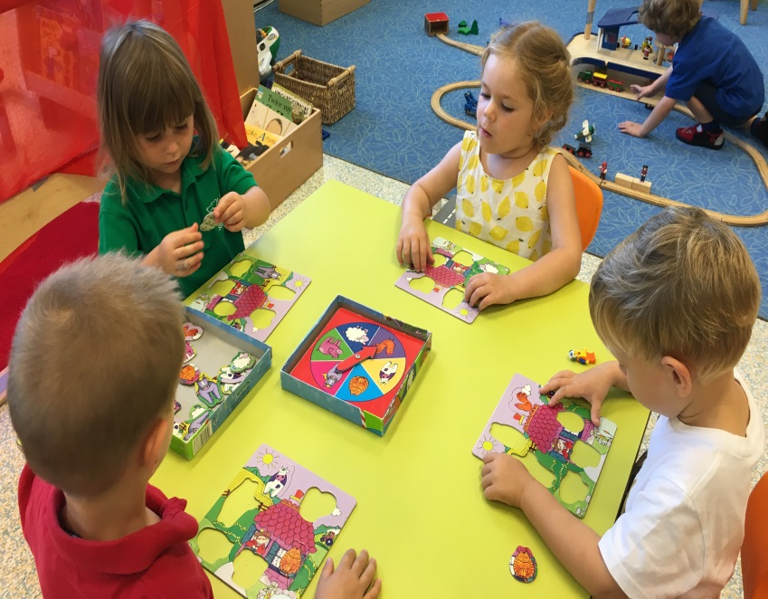
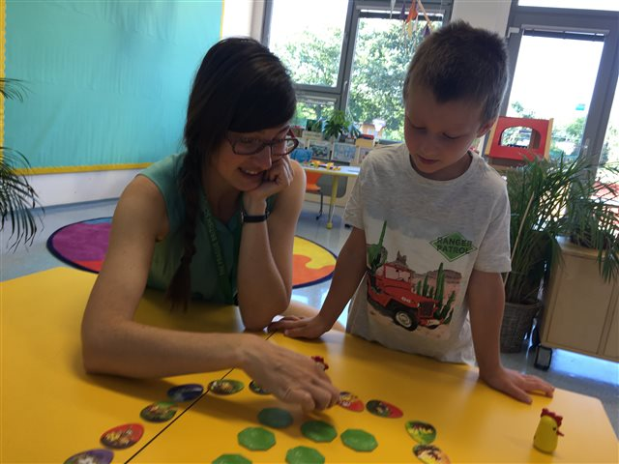
Examples of Activities
Language & Literacy
In the Early Years a lot of emphasis is placed on communicating in English and developing language skills. This is done continuously, and through games, activities and circle times.

Slide 12
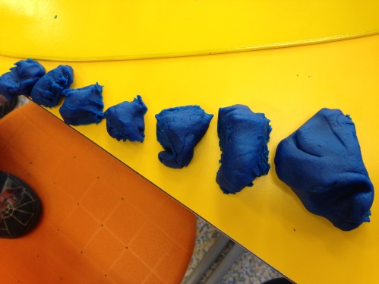
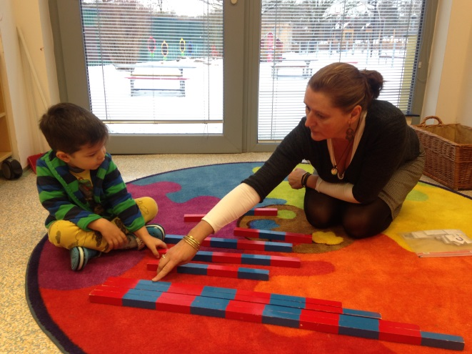
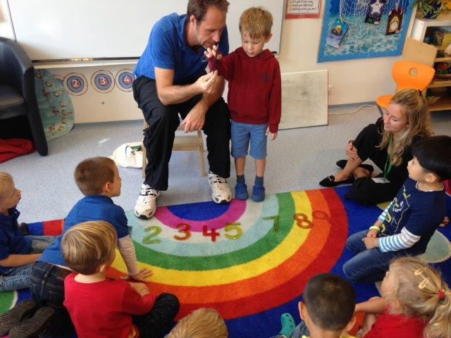
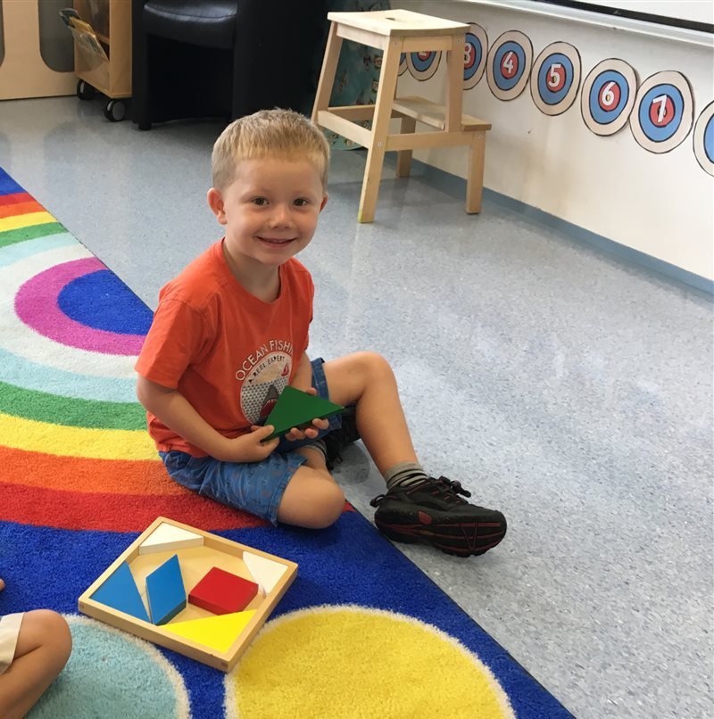
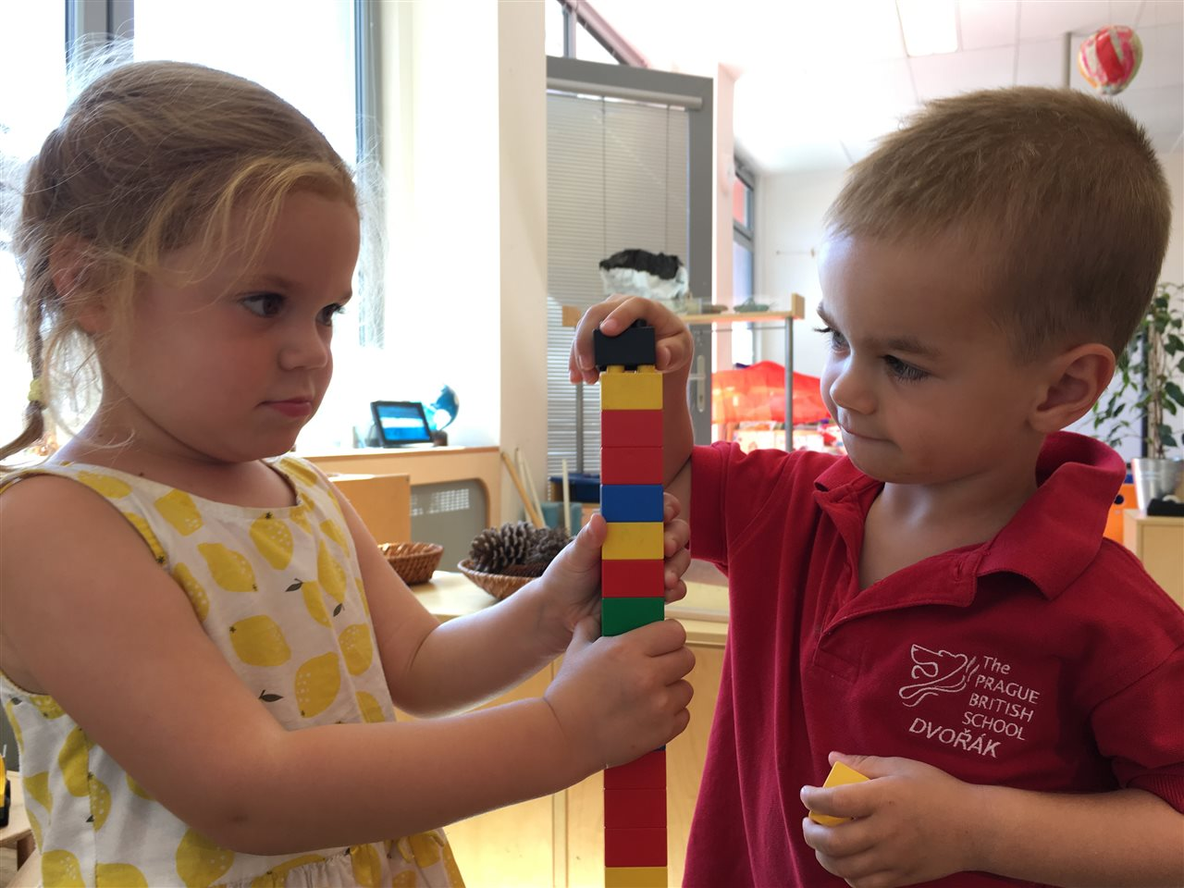
Mathematics
During Mathematics circle times the children may work together or in smaller groups, working with a teacher or teaching assistant.

Slide 13
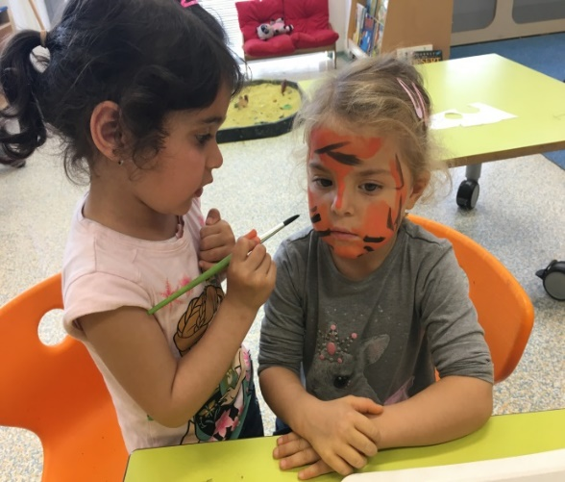
EYCC Focus Activities
We have frequent circle times where the focus
is the current EYCC Concept, which will be followed
up by related activities.
Although the children can choose the
activities they wish to complete, the guided
activities ensure that each child receives a
broad and balanced curriculum throughout the year.
EYCC topics 2019-2020:
The World | Creation | Living Things
Family and Friends

Slide 14
Snack
Children go to the toilet and wash their hands before eating their snack.
Children are to bring a healthy snack from home.
No nuts please, due to allergies.
Hand held food preferred.
Please label your child’s snack box and
water bottle with their name.
We will leave food in the box so you
can see what is leftover.

Slide 15
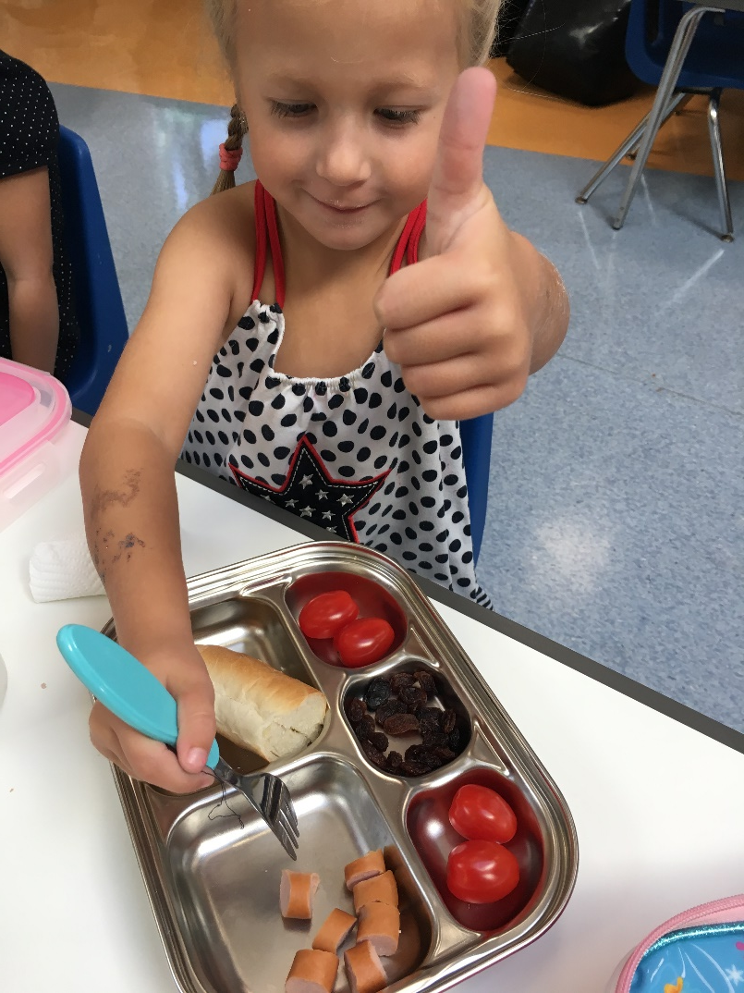
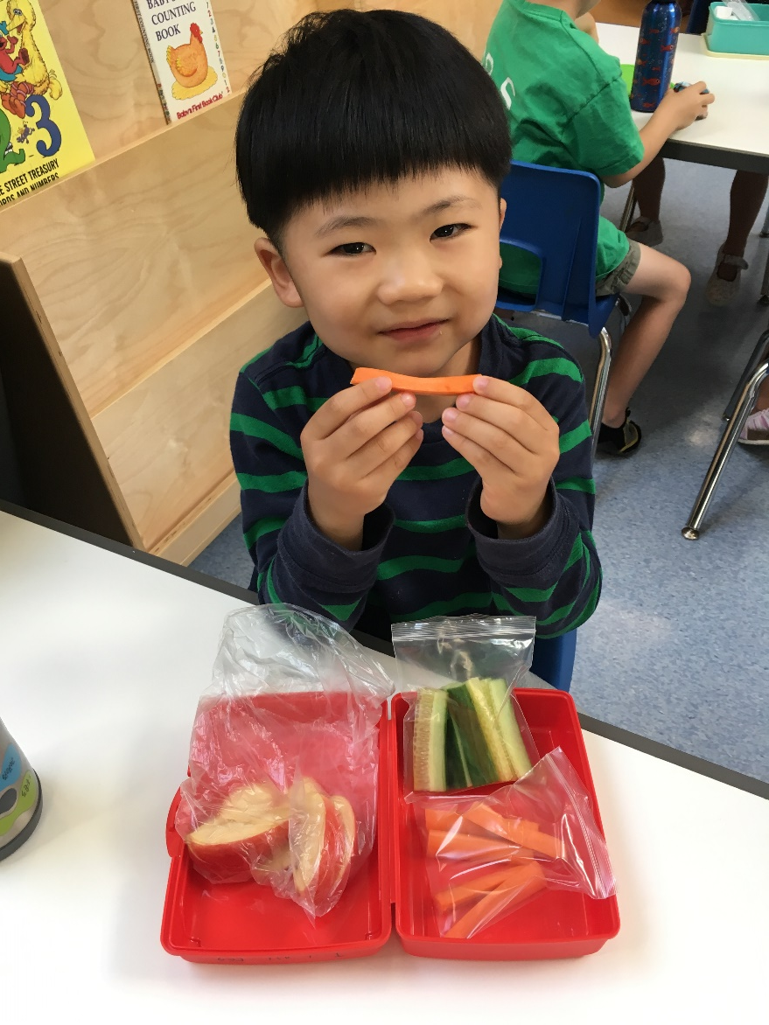
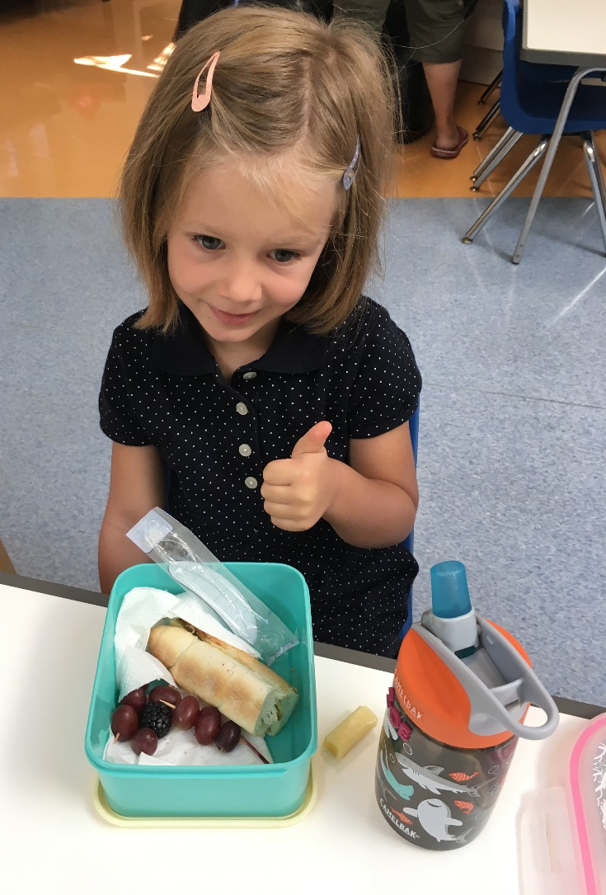

Slide 16
Lunch 11.40 – 12.20
The children are given soup, a main course and a dessert. On Friday they usually get a cold starter.
Children are encouraged to try different foods.
Lunches will be ordered on the VLE. You must tell us either lunch from school OR lunch from home.
Please inform the teacher or Andera if your child has any allergies.

Slide 17
End of the day 3.00 – 3.15pm
The children are given a drink and a small snack at the end of the day.
If another adult is collecting your child please inform the teacher or the administrator and provide a photocopy of their ID.
Please make a moment to say goodbye to the teacher and assistants and we encourage children to do so too.

Slide 18
Cloakroom
All items need to be labelled please.
Developing independence is part of our education.
As is keeping their belongings tidy – coat, shoes etc.
Waterproof clothes, appropriate for all weather.

Slide 19
Weekly Overview
Pre-Nursery will have P.E., Music, library and assembly
Timetable will be emailed to parents

Slide 20
Things to Remember
Worries or concerns: please speak to us!
We have lots of toys in school so we ask you to please leave them at home.
Please check the newsletter every week.

Slide 21
SeeSaw
This is a way for sharing information including photos and videos about what your child has been doing in school.
You will soon receive a login to use this at home.
Please look at it with your child and
feel free to add to it too.

