Slide 1
Early Years 2019 – 2020
PBIS

Slide 2
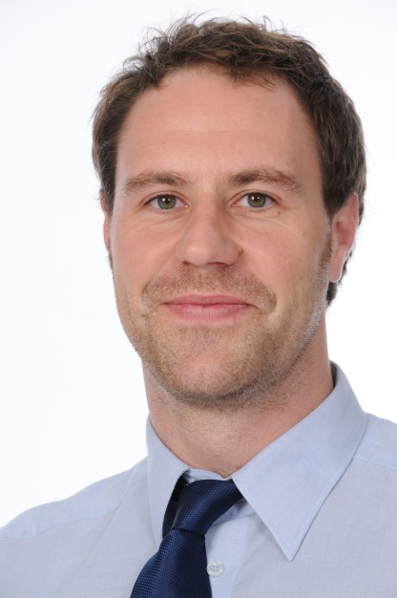
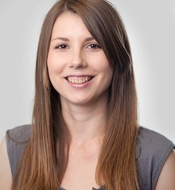
Our staff
Mr Alex Harrison
Deputy Head Kamyk Campus (Early Years)
Responsible for the overall management of the Early Years
Involved throughout Primary school.
Ms Eliška Strnadova
Pre-Nursery Teacher
Early Years Coordinator
Responsible for the day to day running of the Early Years
Notes:
Introduction – as you may or may not know my new role this year is foundation stage coordinator…..

Slide 3
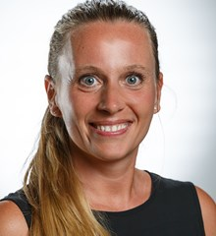
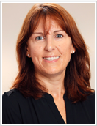
Nursery Teachers
Ms Silvie Flakova
Nursery A Class Teacher
Ms Lesley Eichel
Nursery B Class teacher

Slide 4
Our Staff
Miss Andrea
EY – Year 2 Administrator
Miss Evicka
- catering, cleaning…

Slide 5
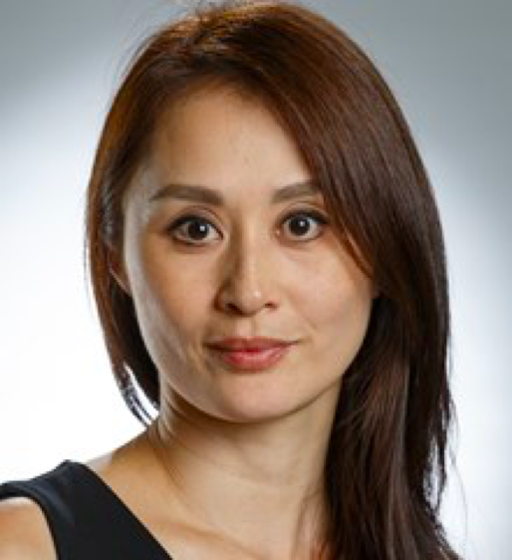
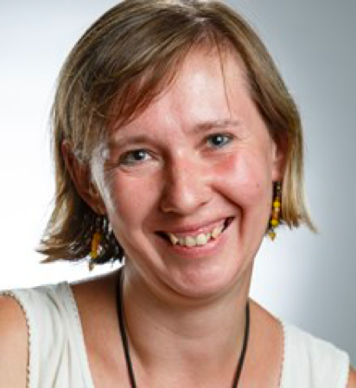
Nursery Teaching Assistants
Ms Yayoi Mrs Sheryl
Ms Zofia Ms. Zuzana

Slide 6
Our Curriculum
Personal, Social and Emotional Development
Self confidence and self awareness
Managing feelings and behaviour
Making relationships
Communication and Language
Listening and attention
Understanding
Speaking
Physical Development
Moving and Handling
Health and self-care

Slide 7
Specific Areas
Literacy
Reading
Writing
Mathematics
Numbers
Shape, space and measures
Understanding the world
People and communities
The World
Technology
Expressive arts and design
Exploring and using media and materials
Being imaginative

Slide 8
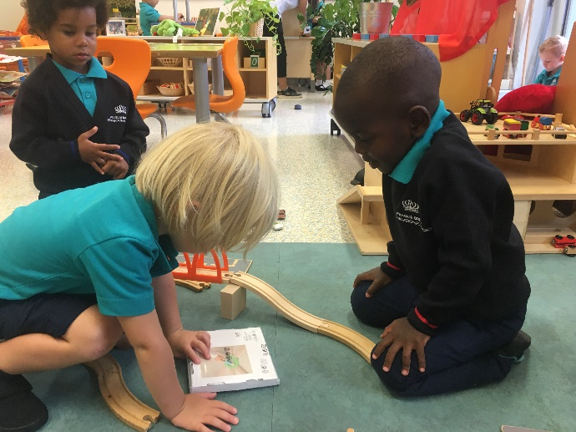
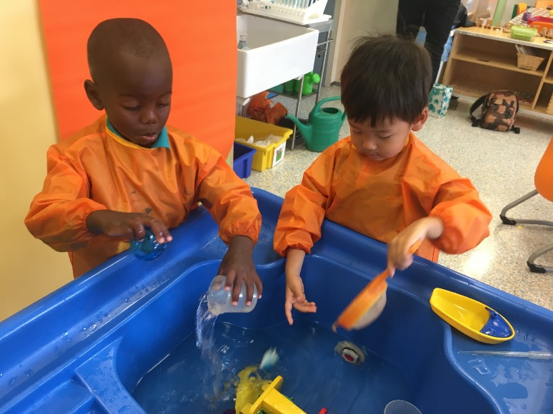
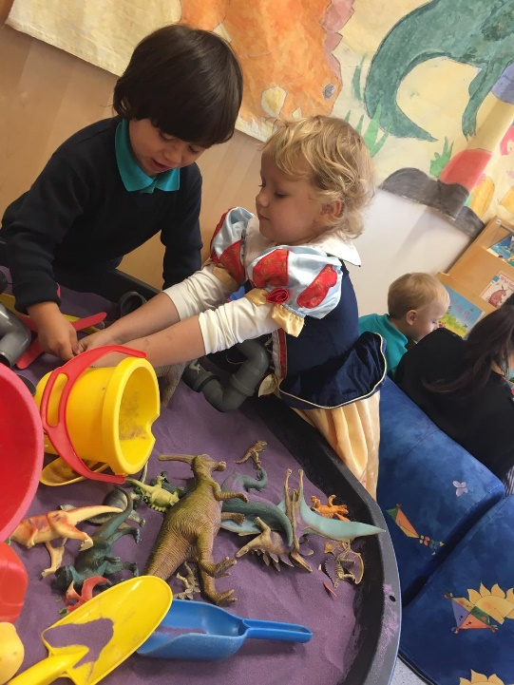
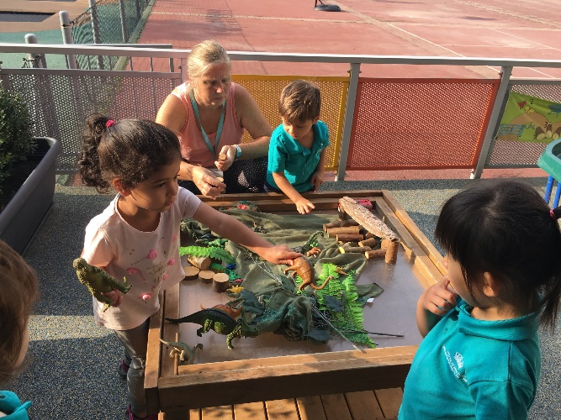
Learning Through Play
• Through play children discover new things about the world they live in.
Children need to be interested in what they are learning and enjoy what they are doing.
• They develop new skills and build new relationships.
All areas of the EYFS are taught cross curriculum throughout the day.

Slide 9
Plan of The Day
8.15am – 9.00am: staggered start + independent activities, communication time. This is often called ‘freeflow’.
9am – 9.30am: Tidy up time and Good Morning circle
9.30am – 10.45am snack and outside play
10.45am – 12.00pm: Circle time with follow up activities
12.00pm – 1.15 pm: lunchtime and outside playtime
1.15pm – 2.45pm: Continuous provision and
small group activities
2.45pm – 3.00pm: Afternoon snack time
3.00pm – 3.15pm: staggered finish, communication
time

Slide 10
Drop Off
The children arrive at school any time from 08.15 am until 08.45 am.
This is also communication time.
Parents are encouraged to bring their child into the classroom and say good morning to the teachers. You are welcome to settle them before saying goodbye.
Teachers encourage the children to choose an activity to complete with their friends.

Slide 11
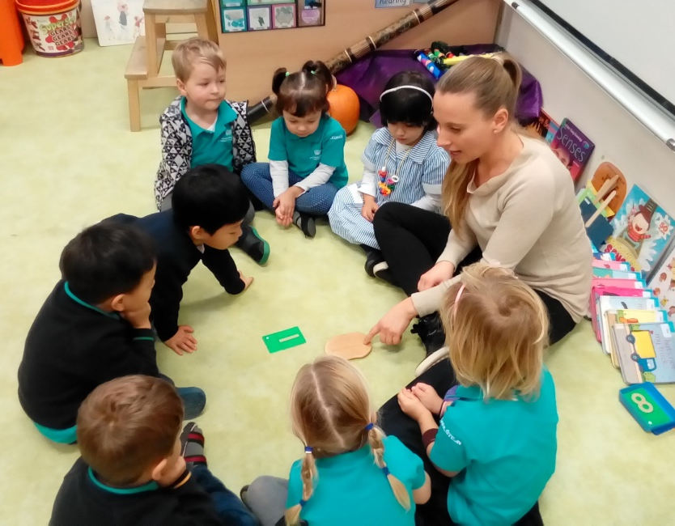
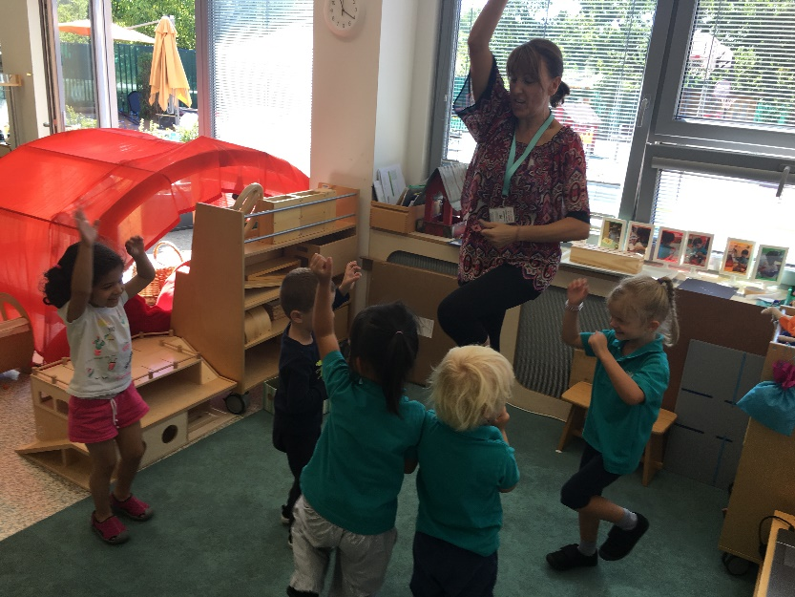
Circle Times
We have circle times every day
The first circle:
Say hello and discuss our day,
Do a dance or sing a song;
We also have focus circle times,
e.g: Language and
literacy, mathematics
or understanding the
World.

Slide 12
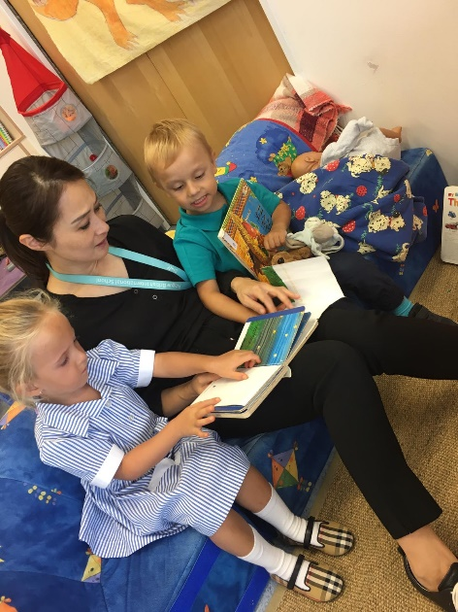
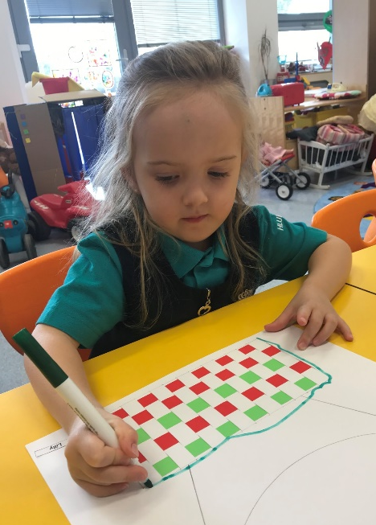
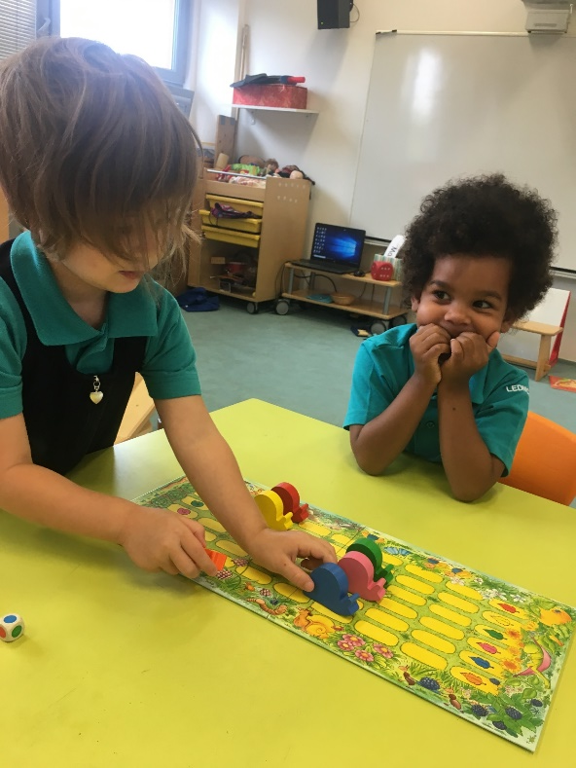
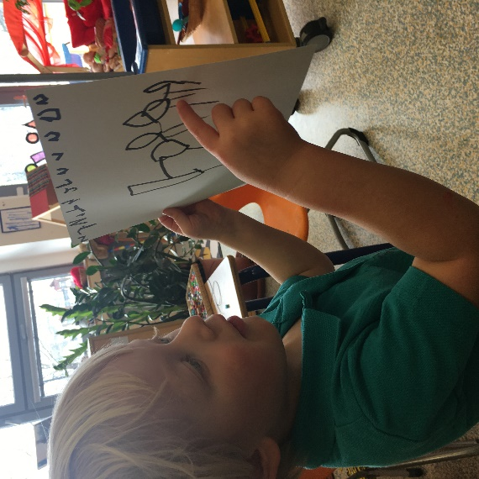
Examples of Activities
Language & Literacy
In the Early Years a lot of emphasis is placed on communicating in English and developing language skills. This is done continuously, and through games, activities and circle times.

Slide 13
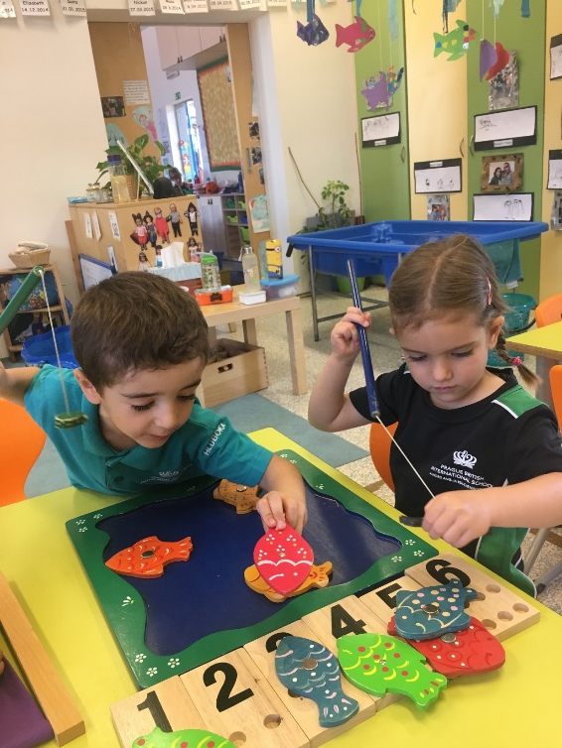
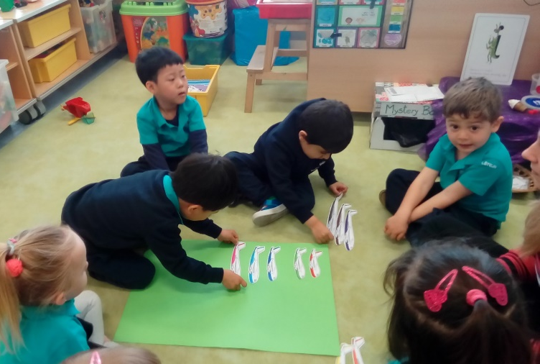
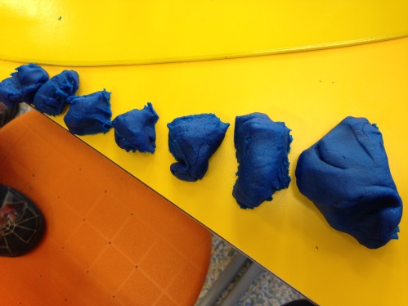
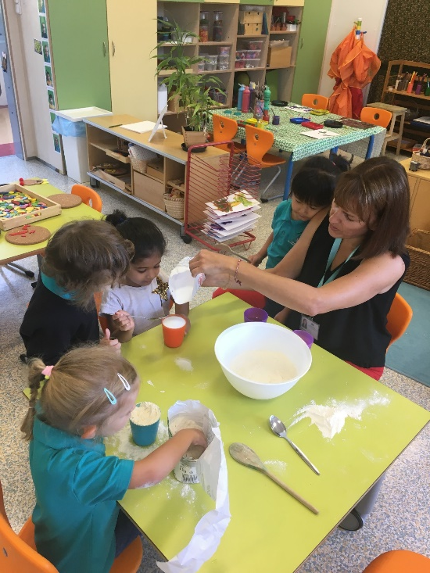
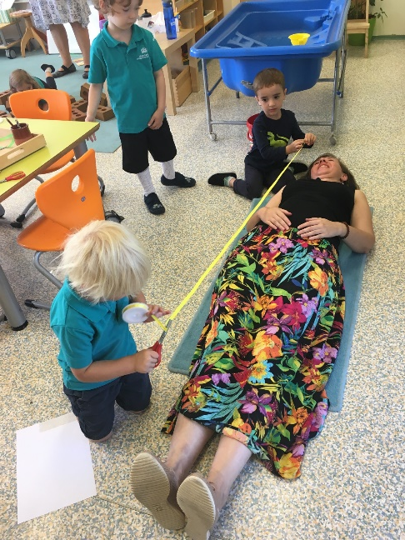
Mathematics
During Mathematics circle times the children may work together or in smaller groups, working with a teacher or teaching assistant.

Slide 14
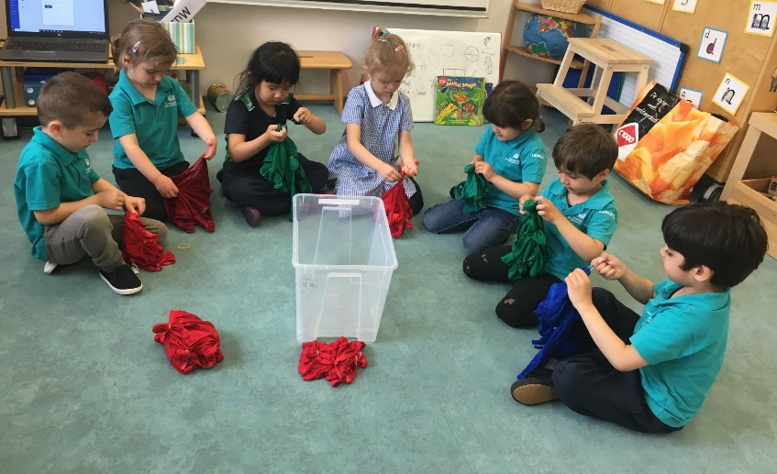
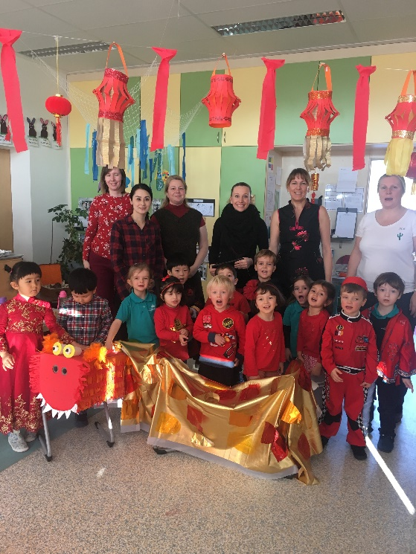
EYCC Focus Activities
We have frequent circle times where the focus
is the current EYCC Concept, which will be
followed up by related activities.
Although the children can choose the
activities they wish to complete, the guided
activities ensure that each child receives a
broad and balanced curriculum throughout the year.
EYCC topics 2019-2020:
The world | Creation | Living things
Family and Friends

Slide 15
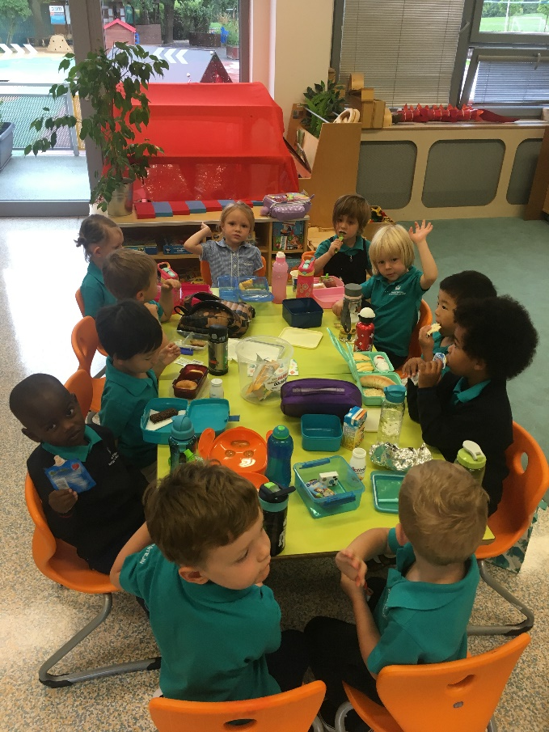
Snack Time
Children go to the toilet and wash their hands before eating their snack.
Children are to bring a healthy snack from home.
No nuts please, due to allergies. We are a nut free school.
Hand held food preferred.
Please label your child’s snack box and water bottle with their name.
We will leave food in the box so you can see what is leftover.

Slide 16
Nursery Lunch 11.50-12.20
The children are given soup, a main course and a dessert. On Fridays there is a different starter.
Children are encouraged to try different foods and eat at least half of the portion given.
Lunches will be ordered on the VLE. You must tell us either lunch from school OR lunch from home.
Please inform the teacher or Andrea if your child has any allergies.

Slide 17
End of the day 2.45 – 3.00pm
A small snack will be provided by school.
If another adult is collecting your child please inform the teacher and provide a photocopy of their ID.
Please make a moment to say goodbye to the teacher or assistant and we encourage children to do so too.

Slide 18
Cloakroom
All items need to be labelled please.
Please replace items of spare clothing that has been used.
Developing independence is part of our education.
As is keeping their belongings tidy – coat, shoes etc.
Waterproof clothes, appropriate for all weather. There’s no such thing as bad weather, only bad clothing!

Slide 19
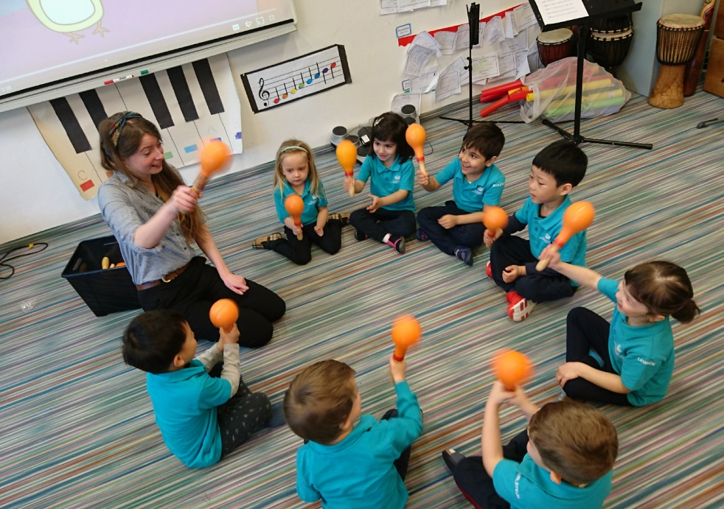
Weekly overview
Thursday: Tigers and lions Music 11.20am – 12.50am
Wednesday : P.E. for both Nursery Classes 1.20pm – 1.50pm
Library: to be confirmed by class teacher
Forest school: Friday afternoons

Slide 20
Things to Remember
PE Kits and suitable sports shoes on Wednesdays
Worries or concerns: please speak to us!
We have lots of toys in school so we ask you to please leave them at home.
Please check the newsletter every week.

Slide 21
SeeSaw
This is a way for sharing information including photos and videos about what your child has been doing in school.
You will soon receive a login to use this at home.
Please look at it with your child and feel free to add to it too.

Slide 22
Informal Parent Meeting
In order to help us get to know a little bit more about your child and his/her family life, we would like to meet you for an informal meeting during September.
Please talk to your child’s class
teacher to arrange an appointment.

